Slide 1
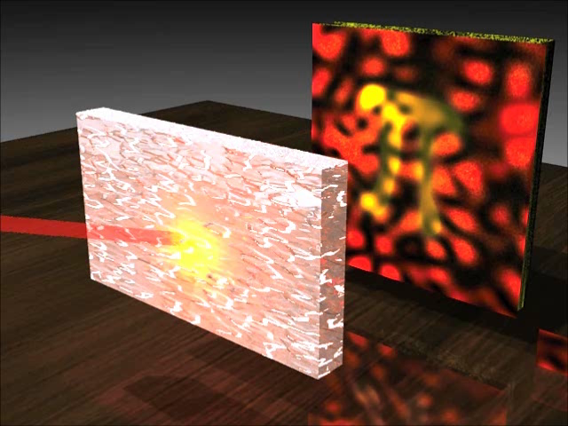
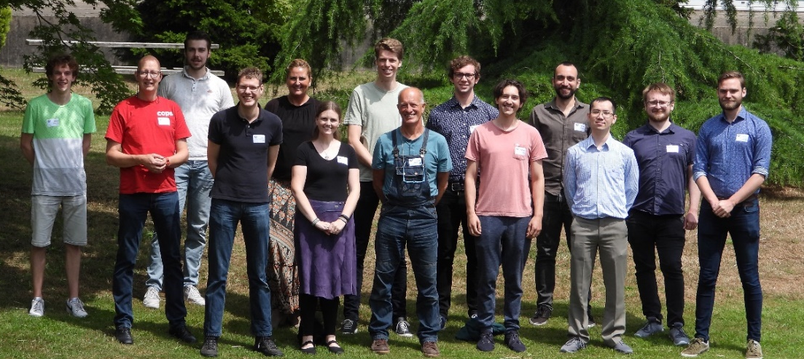
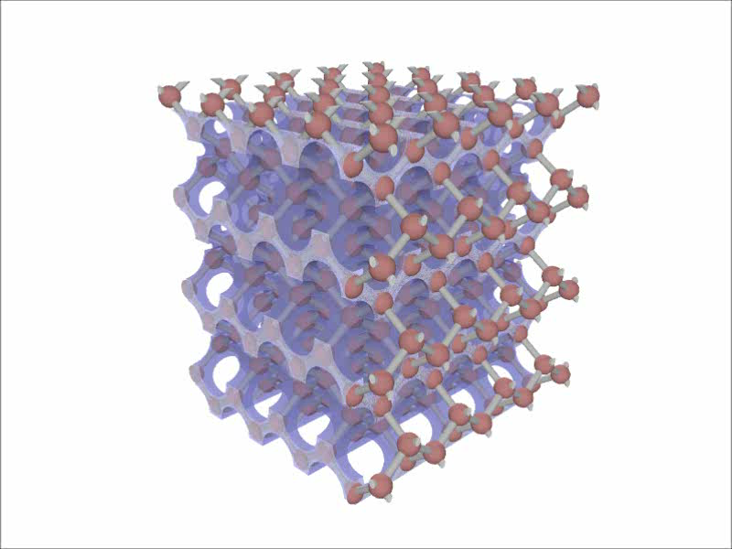
Introduction to “Complex Photonic Systems” (COPS) at the UT
Willem Vos
Complex Photonic Systems (COPS)
MESA+ Institute for Nanotechnology
Dept. of Science & Technology, UT
https://nano-cops.com

Slide 2
Welcome to COPS labs!
Meander ground floor
Best espresso on campus!
(Real professional Vibiemme high-pressure 3-piston machine, if ya know whaddimsayin’ ;-)
If you are somewhere nearby, don’t be shy & come over

Slide 3
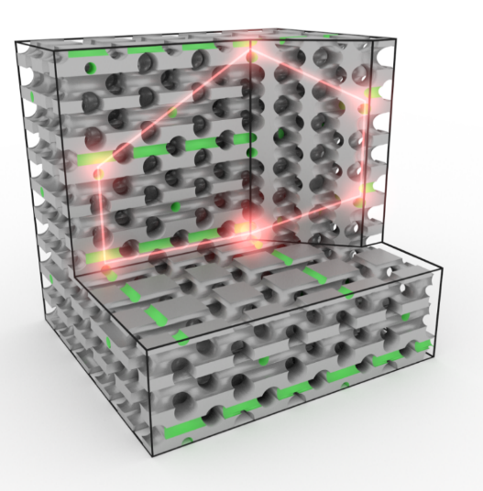
What do the COPS do?
We control the propagation &
the emission of light
This allows us to:
“Unscatter” scattered light
& look through opaque screens!
Have photons “run in circles”
Control emission by quantum systems
& slow down light (down to v = 0!)
& interfere, even single photons
Our know-how is used by high-tech industry, e.g., ASML, Addoptics, Anteryon, Demcon, Schott, Signify, TNO
van Putten & Mosk,
Physics 3 (2010) 22

Slide 4
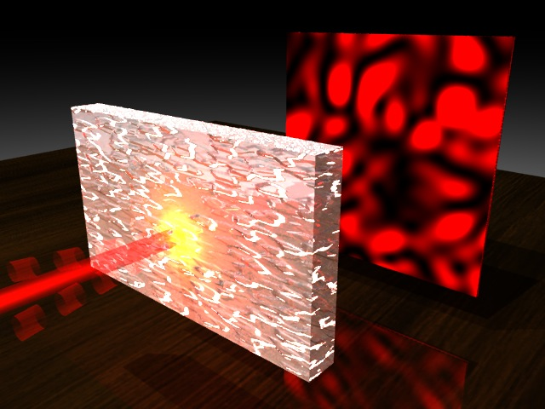
Scattering of light
In a nanophotonic material
light scatters many, many
(~10⁶) times
For example: paint, foam,
biological tissue, etc.
Scattering described by a matrix S
Output from sample is random
interference: speckle!
S

Slide 5
“Unscatter” scattered light
“S⁻¹”
S
If we can invert S, can we undo the scattering ?
Yes!
yes we can
Originally invented by COPS!
A. Mosk, A. Lagendijk, G. Lerosey & M. Fink, Nature Photonics 6 (2012) 283

Slide 6

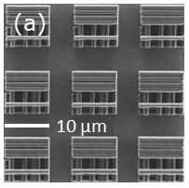
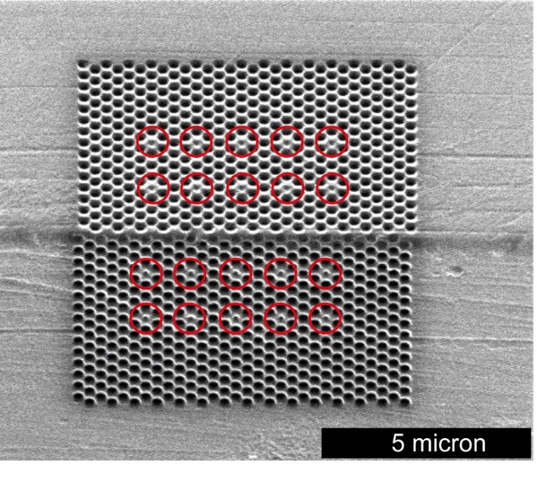
Light in a nano-maze
CMOS-compatible
3D Si nanophotonics
Direct laser writing
We fabricate tailor-made nanostructures to “tease” light, using:
Litho + etching, self-assembly (colloids), direct laser writing, etc.
⇒ We also study nanomaterials, and even chemistry

Slide 7
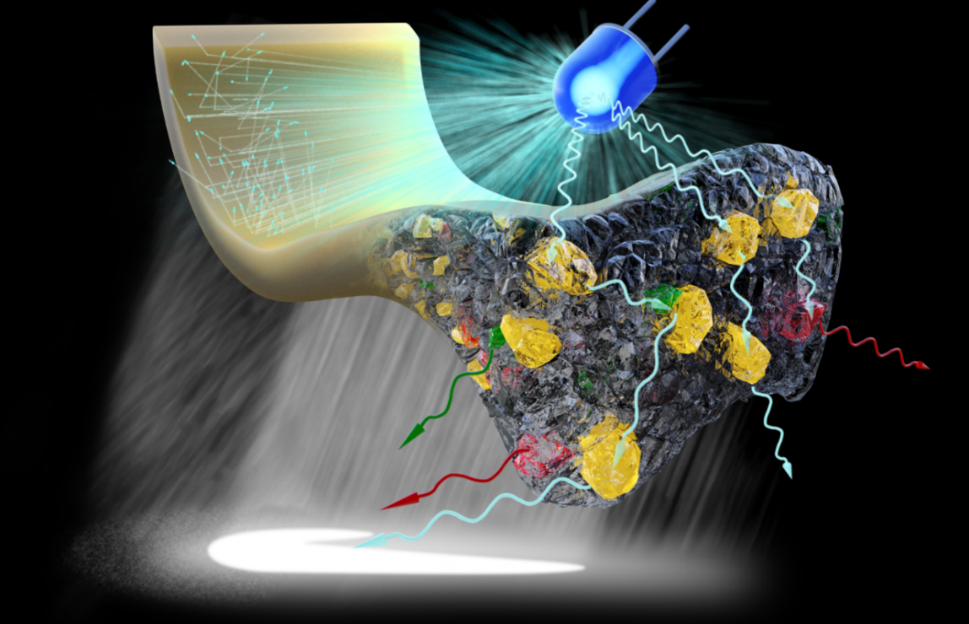
Scattering with industry!
For applications like:
CMOS-chip making,
daily LED lighting,
Satellites that observe
pollution …
Industry needs to know
Much more about
scattering in optics with any shape: free form optics
Hence COPS collaborates with: ASML, Signify (former Philips Lighting), Lumileds, TNO, Schott, Demcon,
& teams at TUe & TUD & ARCNL

Slide 8


SAXION International Project Week 2024
University of Twente: COPS/TNW
Willem Vos
Cock Harteveld
Geert Jan Kamphuis
Melissa Goodwin

Slide 9
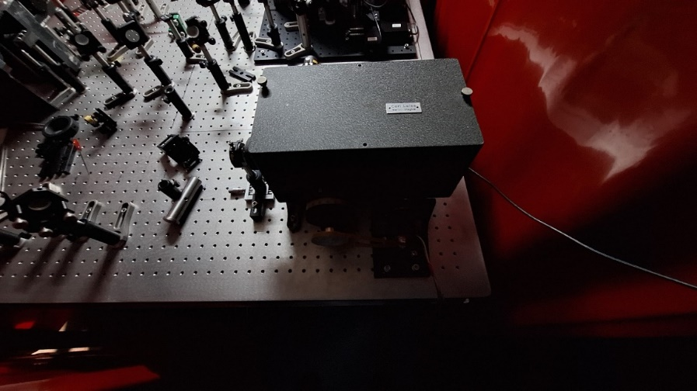
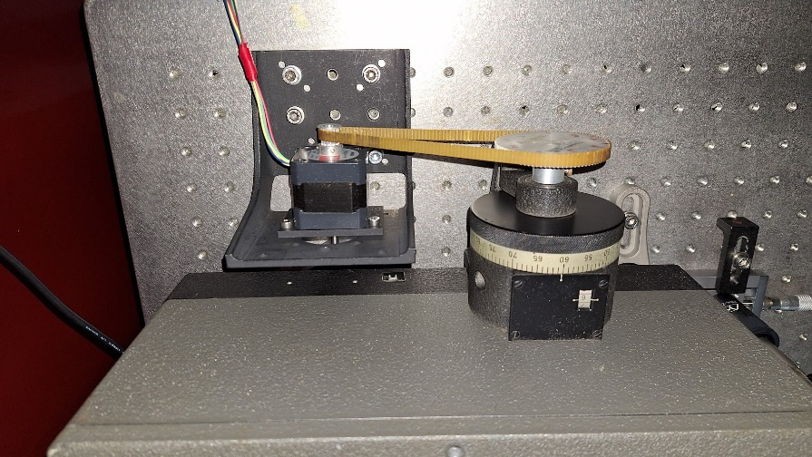
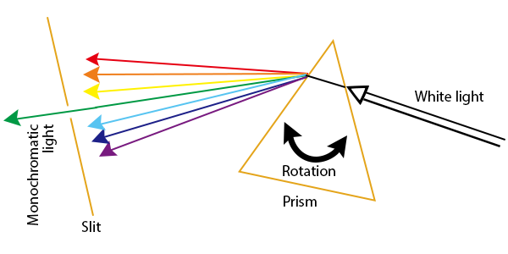
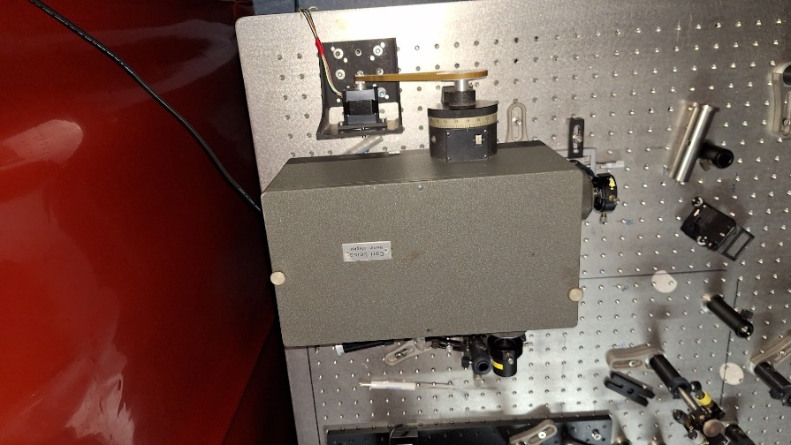
Project 1:

Slide 10
Project 1: automatic wavelength selection with stepper motor for Carl Leiss prism spectrometer by Arduino micro controller
Mechanical construction with stepper motor and drive belt for rotating the wavelength selection prism: available, see picture
Rotation control stepper motor with micro steps and macro steps
Position detection stepper motor( encoder), there is a fixed gear between belt wheel and prism
Encoder table vs wavelength
User friendly, interface :USB controller and notebook to micro controller

Slide 11
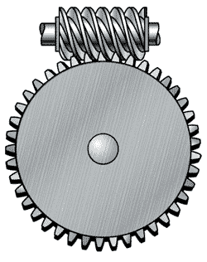
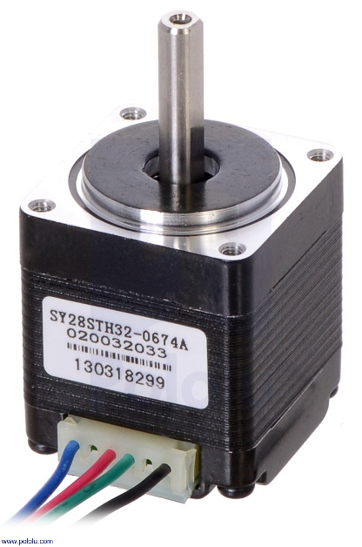

Slide 12
Additional information
Arduino Uno R3 micro computer
CNC shield V3, controller board for 4 stepper motors
Motor driver module
Stepper motor( open loop, closed loop is in backorder) with pulley and bracket ( prepare the controller for closed loop with microsteps and encoder readout, test run with open loop)
Power supply for motor
By given gear ratio calculate the number of (micro)steps per wavelength unit (nm)
Include home position for open loop acting
35 sensor module, pick one or two sensors and surprise us

Slide 13
Project 2: build Arduino based controller for four simple actuators to move beam block, shutter or polarizer
Switch several optical beams in complex optical setup without direct touching the setup.
To do:
Design and program Arduino mini pc for controlling four actuators like servo motors or lineair dc motor
Design mechanical holder servo’s and shutter( 3D print?)
The shutters are placed in all arms of an interferometer and make it possible to alter the measure arm or reference arm.
User friendly interface( USB controller and notebook) to microcontroller

Slide 14
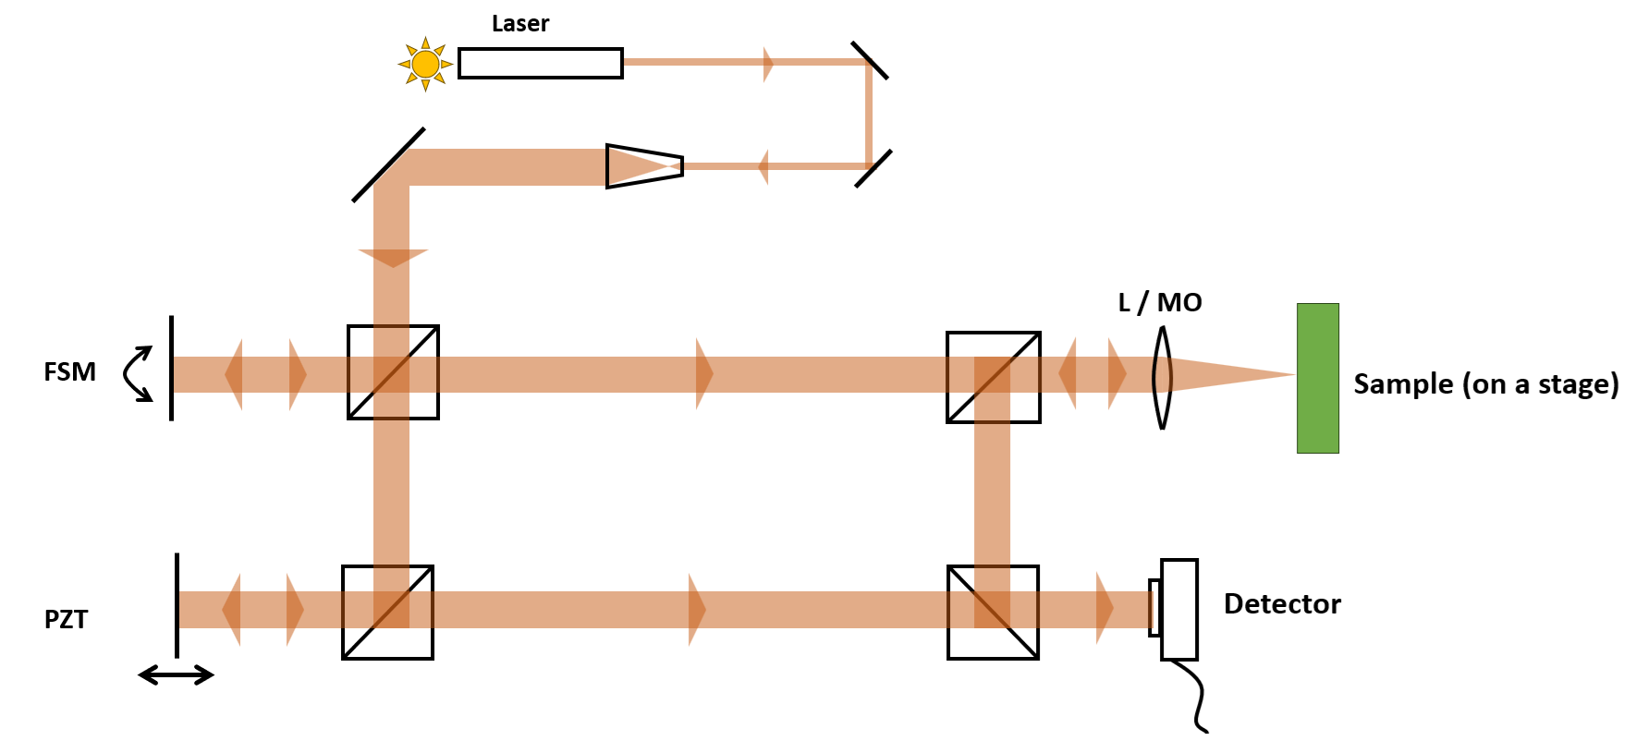
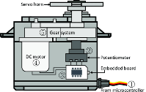
Project 2:

Slide 15
Additional information
2 pieces mini servo, 180 deg
1 piece mini servo continuous rotation
Arduino Uno R3 micro computer
16 channel servo controller
Servomotor activated by pushbutton or switch on breadboard
Measure light with photodiode in one of the beam paths( input)
35 sensor module, pick one or two modules and surprise us

Slide 16
Project 3: Reproducible formation of films from colloidal suspensions
Challenge: Design a controllable, reproducible method of creating films of varying thickness from colloidal suspensions of (polymer) beads
Decide on a method of deposition: e.g. spray paint, spinning, inkjet printing
Develop a method of automating and reproducing the deposition
Is there a way to reduce cracking of the films in thicker samples?
Can the order and disorder be varied?

Slide 17
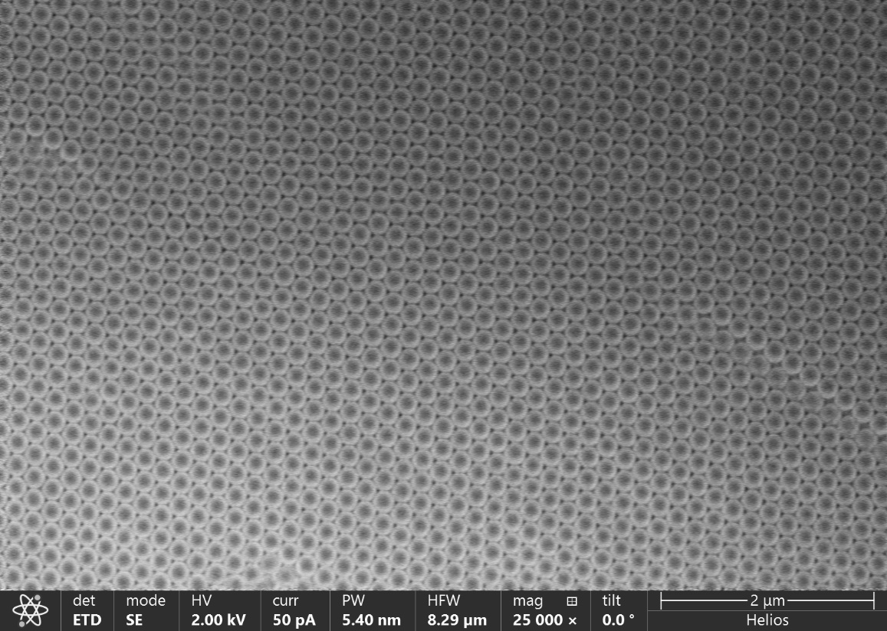
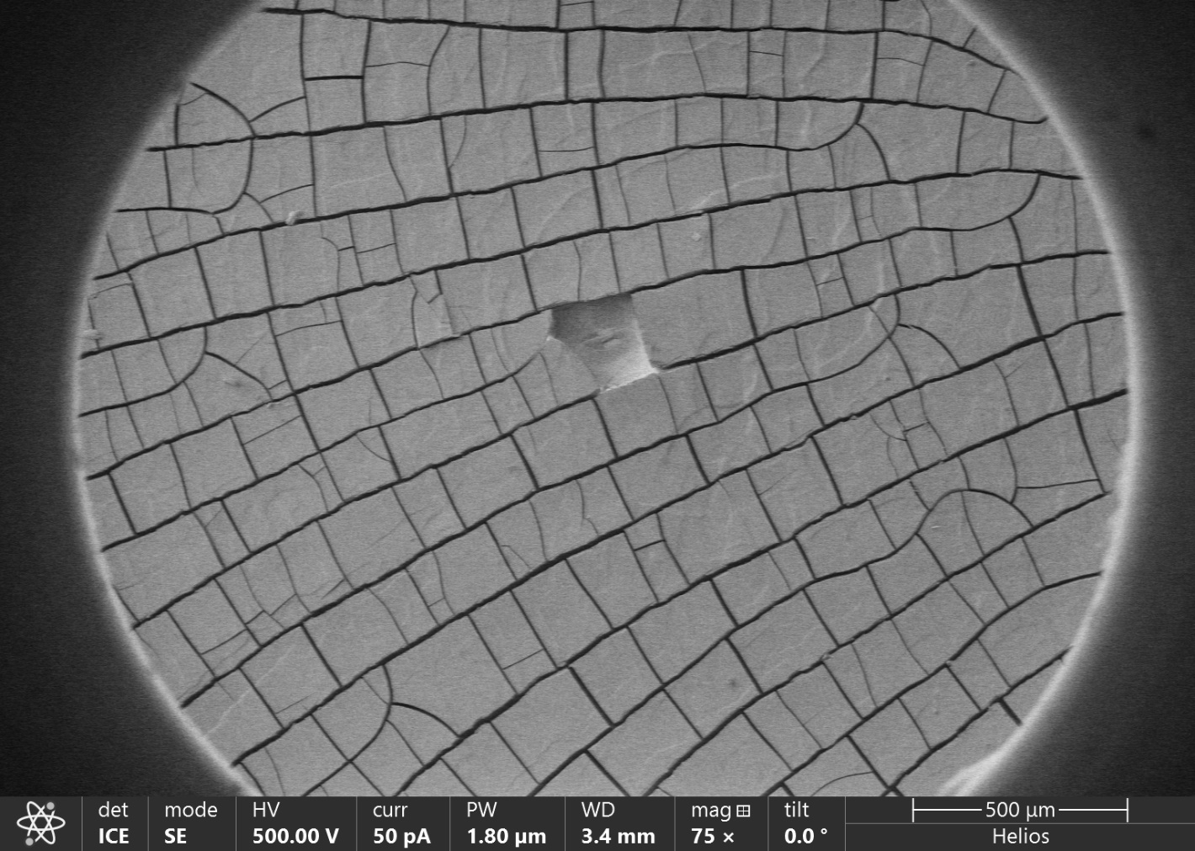
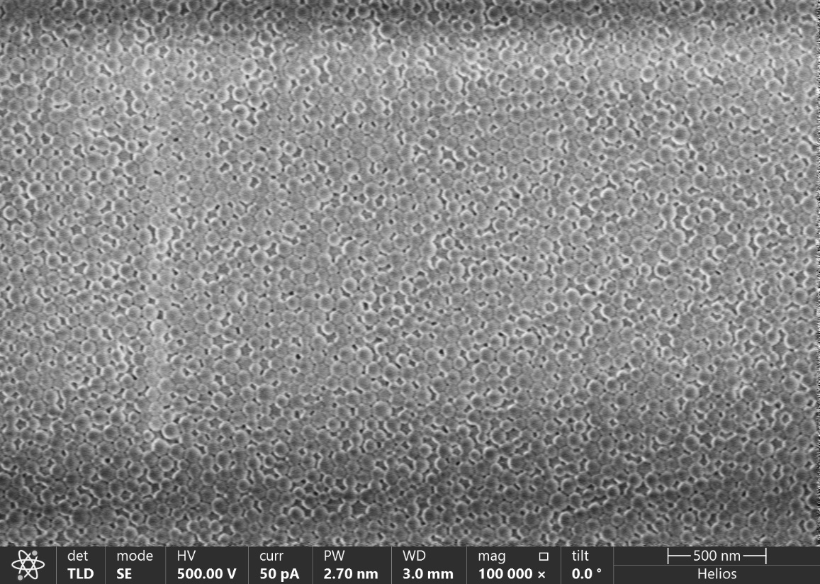
Project 3:
Ordered beads
Disordered beads
Cracks in thicker films

