Slide 1
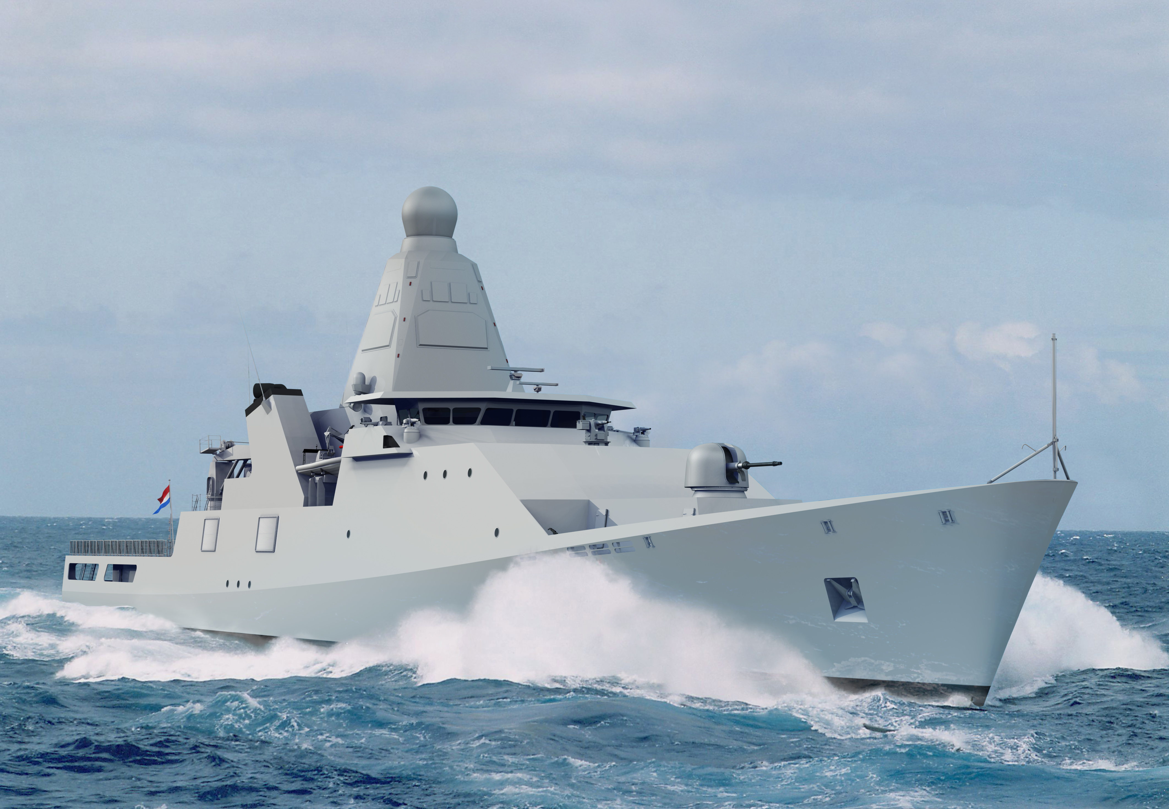
Effects, Estimation, and Compensation of Frequency Sweep Nonlinearity in FMCW* Ranging Systems
Committee members
Applied Physics | Prof. dr. A.P. Mosk (COPS), ir. R. Vinke (Thales), prof. dr. W.L. Vos (COPS), ir. H.T. Griffioen (Thales)
Applied Mathematics | Dr. G. Meinsma (MSCT), prof. dr. A.A. Stoorvogel (MSCT), dr. A. Zagaris (AAMP)
* Frequency-Modulated Continuous-Wave

Slide 2
Contents
Introduction
Digital chirp generation and its effect on the performance of a FMCW radar
Compensation of frequency sweep nonlinearity by digital post-processing
Applications of FMCW to optics
Conclusions

Slide 3
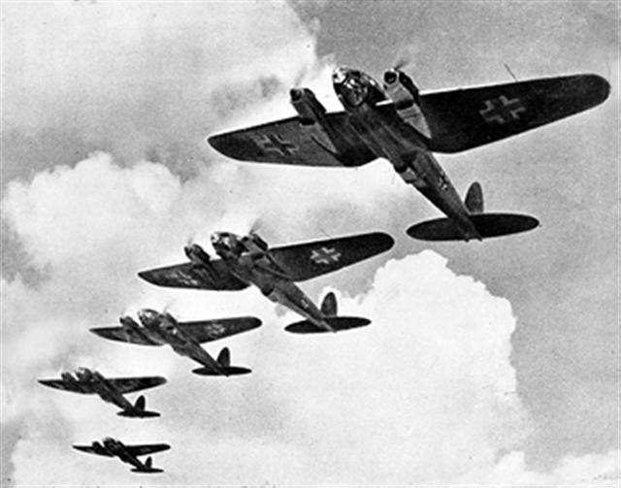
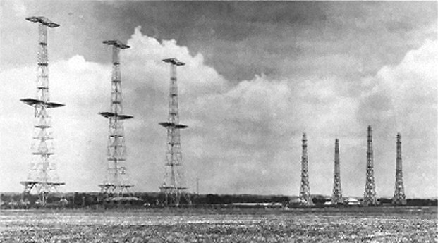
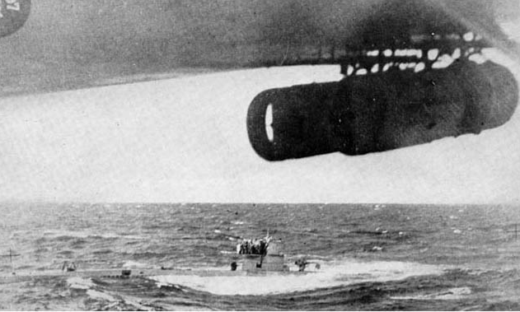
Radar
Radio Detection And Ranging
“To see and not be seen”
Heinkel HE-111 bombers
RAF Chain Home radar site
German U-boat surrendering (depth charge in profile)

Slide 4
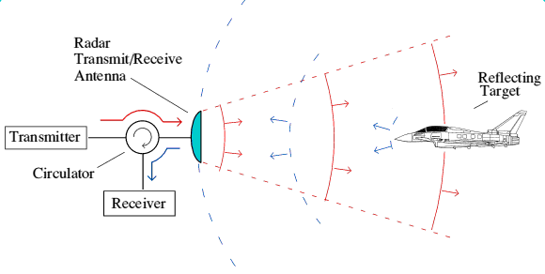
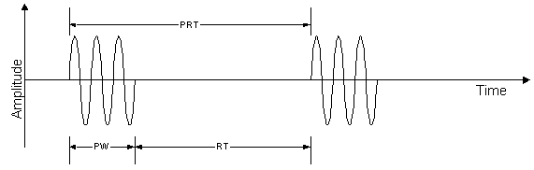
Pulsed radar

Slide 5
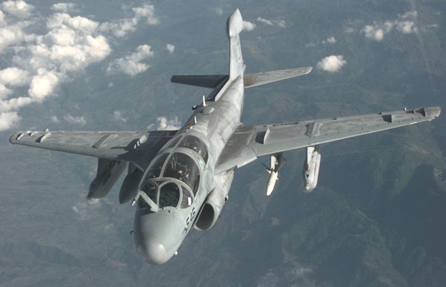
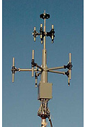
Intercept receivers
Jamming
Direction finding (DF)
Anti-radiation missiles (ARMs)
DRS ZA-4501 shipboard DF antenna array
Prowler armed with HARM high-speed anti-radiation missiles

Slide 6
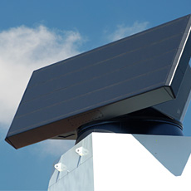
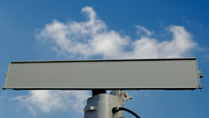
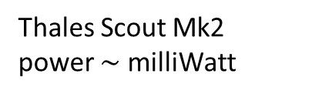
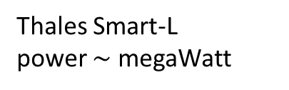
LPI radar
Low probability of intercept
power
pulse with high peak power
continuous wave with low peak power
Thales Smart-L
power $\sim$ megaWatt
time
Thales Scout Mk2
power $\sim$ milliWatt

Slide 7
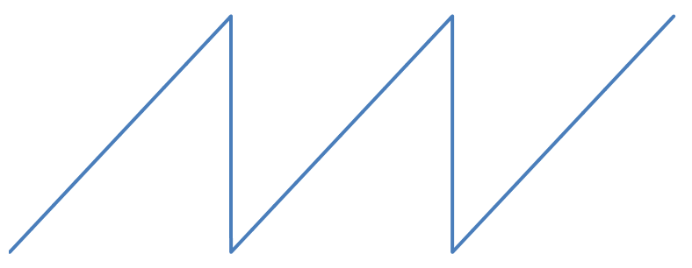
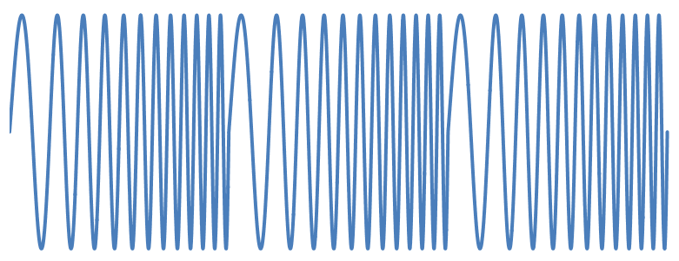
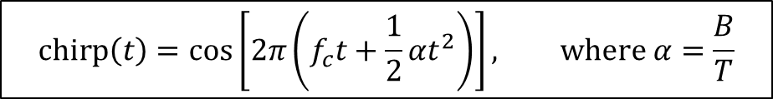
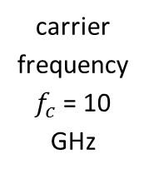

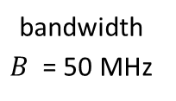
FMCW radar
Frequency-modulated continuous-wave
frequency
bandwidth $B$ = 50 MHz
carrier frequency $f_{c}$ = 10 GHz
sweep period $T$ = 500 µs
time
amplitude
time
$$chirp\left(t\right)=\cos\left[2π\left(f_{c}t+\frac{1}{2}αt^{2}\right)\right], where α=\frac{B}{T}$$

Slide 8
Principle of FMCW ranging
transmitted linear chirp
frequency
received echoes
time
frequency difference
target ‘beat’ frequencies
time

Slide 9
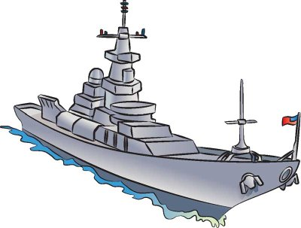
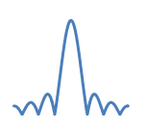
FMCW transceiver
chirp generator
transmit antenna
frequency
coupler
time
LO
RF
mixer
target
power
IF
receive antenna
spectrum analyzer
frequency

Slide 10
Frequency sweep nonlinearity
transmitted non-linear chirp
frequency
received target echoes
time
beat frequency
time

Slide 11

“Ghost” targets
transmitted non-linear chirp
frequency
received target echo
power
target
“ghost” targets
time
beat frequency
time
frequency

Slide 12
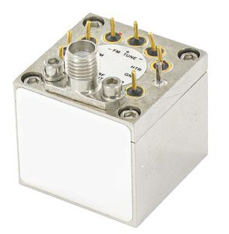
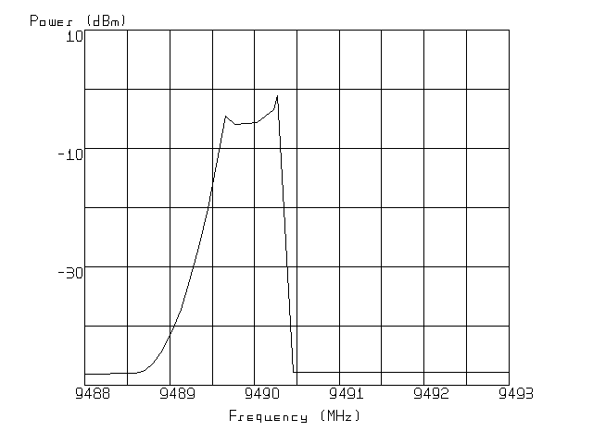
Analog chirp generation
YIG (Yttrium, Iron, and Garnet)-tuned oscillator
A.G. Stove, Measurement of Spectra of Microwave FMCW Radars, Thales Aerospace UK, working paper (2006).

Slide 13
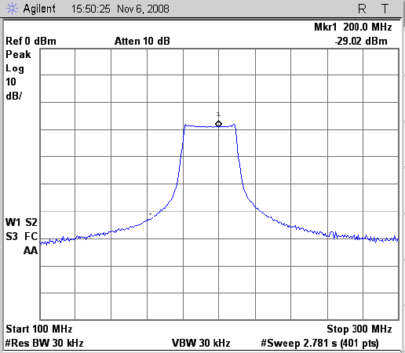
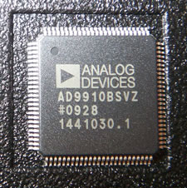

Digital chirp generation
Direct digital synthesizer (DDS)
address generator
RAM or ROM
D/A converter
low-pass filter
to transmitter
clock
Clock speed 1 GSPS
Integrated 14-bit DAC
Output of a AD9910 sweeping from 180 MHz to 210 MHz
Source: J. Ledford, Master’s Thesis, University of Kansas (2008).

Slide 14
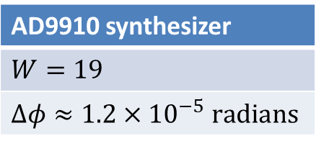

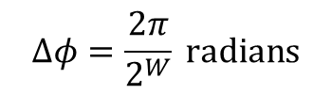


Quantization of phase
‘phase accumulator’
sine look-up table (ROM)
‘jump’ size
$$0000…0$$
$$1111…1$$
$$Δφ$$
clock
AD9910 synthesizer
$W=19$
$Δφ≈1.2×{10}^{−5} radians$
$$Δφ=\frac{2π}{2^{W}} radians$$
$$W=number of bits of the phase accumulator$$

Slide 15
Worst-case “ghost” target
‘Spurious-free dynamic range’
“Ghost” targets practically negligible
$$SFDR=20\log_{10}\left(2Δφ\right)≈92 dB$$
power
SFDR = 92 dB
frequency

Slide 16






Compensation of phase errors
Burgos-Garcia et al., Digital on-line compensation of errors induced by linear distortion in broadband FM radars, Electron. Lett. 39(1), 16 (2002).
Meta et al., Range non-linearities correction in FMCW SAR, IEEE Conf. on Geoscience and Remote Sensing 2006, 403 (2006).

Slide 17
Remember this?
frequency
time
intermediate frequency (IF)
time

Slide 18



Compensation algorithm
collected non-linear deramped data
$$f_{b}$$
transmitted non-linearties removal
time
$$f_{b}$$
range deskew
time
$$f_{b}$$
non-linearities compensation
time
$$f_{b}$$
linear deramped data
time

Slide 19









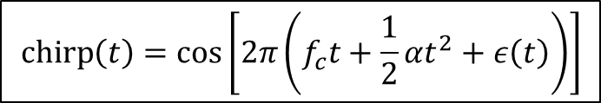
Implementation
$$Q_{−α}(f)$$
$$s_{IF2}$$
deskew filter
$$s_{IF3}$$
$$s_{IF}$$
$$s_{IF4}$$
$$s_{ε}^{∗}\left(t\right)$$
$s_{ε}\left(t\right)∗q_{α}\left(t\right)$ | “Peek”
$s_{ε}\left(t\right)∗q_{−α}\left(t\right)$ | “Meta”
$s_{ε}\left(t\right)$ | “Burgos-Garcia”
$$chirp\left(t\right)=\cos\left[2π\left(f_{c}t+\frac{1}{2}αt^{2}+ε\left(t\right)\right)\right]$$
$$s_{ε}\left(t\right)=\exp\left[j2πε\left(t\right)\right]$$
$$Q_{−α}\left(f\right)=\exp\left(j\frac{π}{α}f^{2}\right)$$
phase error

Slide 20
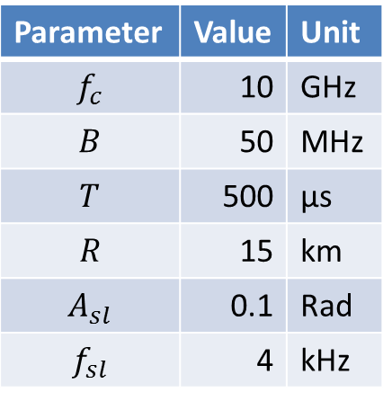
Sinusoidal phase error (low frequency)
$$2πε\left(t\right)=A_{sl}\sin\left(2πf_{sl}t\right), f_{sl}≪\sqrt{α}$$
Parameter | Value | Unit
$$f_{c}$$ | 10 | GHz
$$B$$ | 50 | MHz
$$T$$ | 500 | μs
$$R$$ | 15 | km
$$A_{sl}$$ | 0.1 | Rad
$$f_{sl}$$ | 4 | kHz

Slide 21
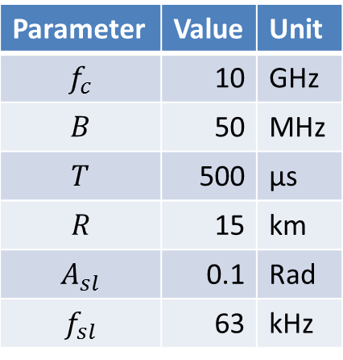
Sinusoidal phase error (high frequency)
$$2πε\left(t\right)=A_{sl}\sin\left(2πf_{sl}t\right), f_{sl}\sim \sqrt{α}$$
Parameter | Value | Unit
$$f_{c}$$ | 10 | GHz
$$B$$ | 50 | MHz
$$T$$ | 500 | μs
$$R$$ | 15 | km
$$A_{sl}$$ | 0.1 | Rad
$$f_{sl}$$ | 63 | kHz

Slide 22
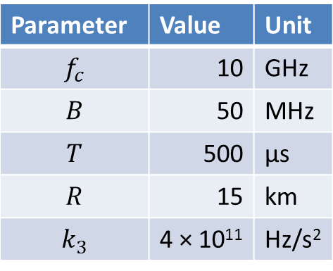
Cubic phase error
$$2πε\left(t\right)=k_{3}t^{3}$$
Parameter | Value | Unit
$$f_{c}$$ | 10 | GHz
$$B$$ | 50 | MHz
$$T$$ | 500 | μs
$$R$$ | 15 | km
$$k_{3}$$ | 4 × 10¹¹ | Hz/s²

Slide 23

Quartic phase error
$$2πε\left(t\right)=k_{4}t^{4}$$
Parameter | Value | Unit
$$f_{c}$$ | 10 | GHz
$$B$$ | 50 | MHz
$$T$$ | 500 | μs
$$R$$ | 15 | km
$$k_{4}$$ | 4 × 10¹¹ | Hz/s²

Slide 24
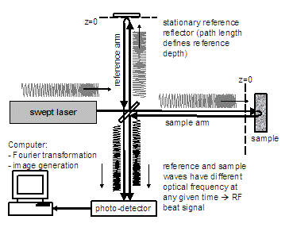
FCMW in optics
Swept-Source Optical Coherence Tomography
Compensation algorithm not in the literature!
3D image of a frog tadpole using a Thorlabs OCS1300SS OCT microscope system.

Slide 25
Conclusions
Phase quantization effects in digital chirp synthesizers have negligible effect on performance
Frequency sweep nonlinearity can be compensated by digital post-processing of the beat signal
Algorithm is also applicable to optics, but not mentioned in optics literature

Slide 26
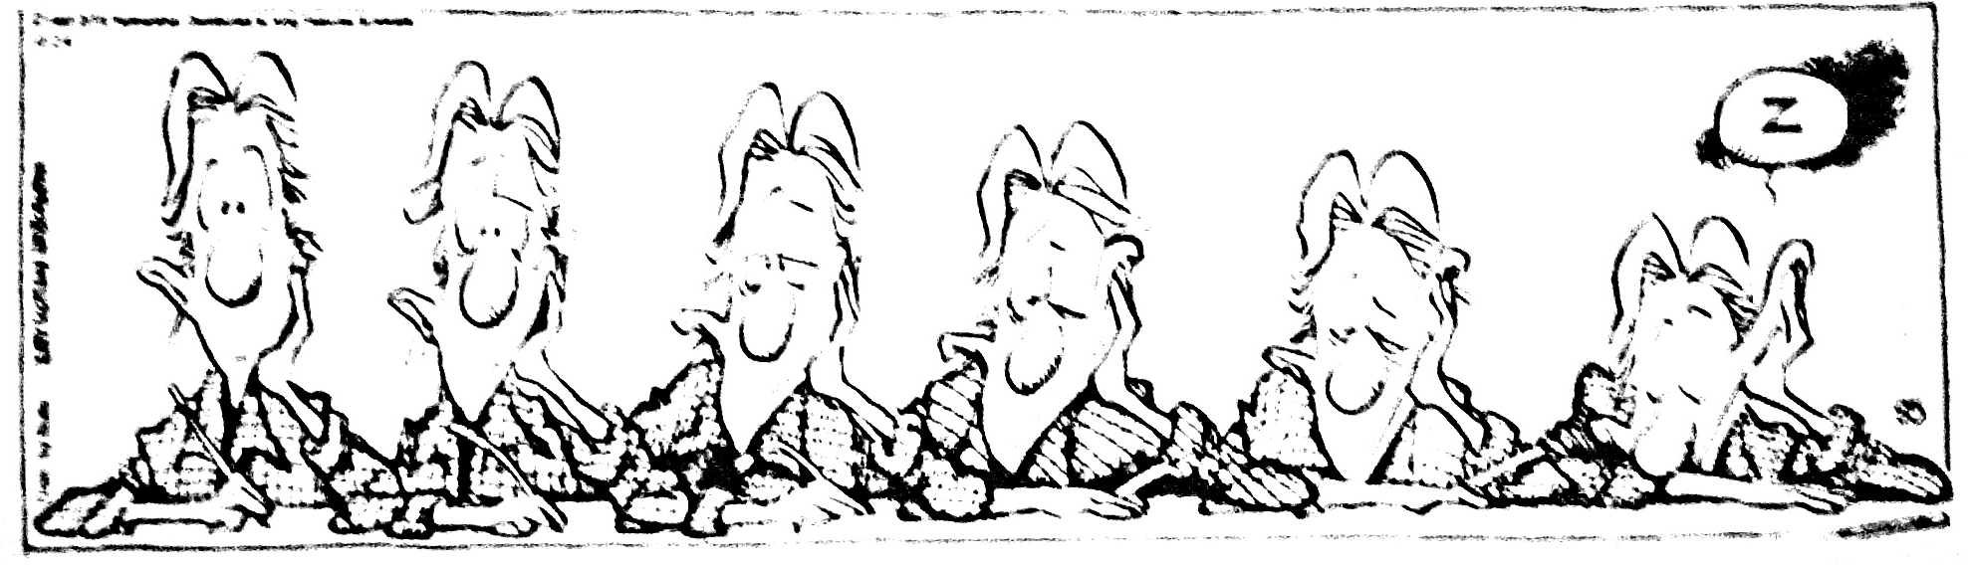

Thank you for your attention!
Questions?

Slide 27
Extra slides

Slide 28
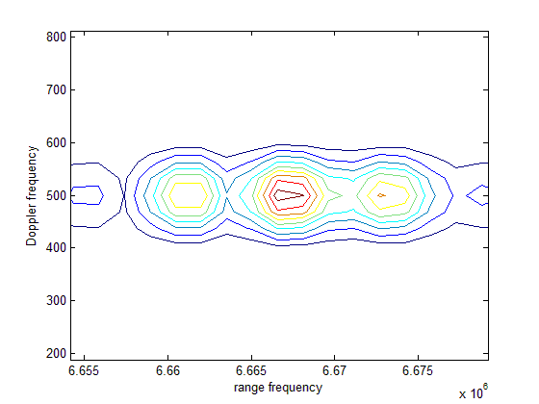
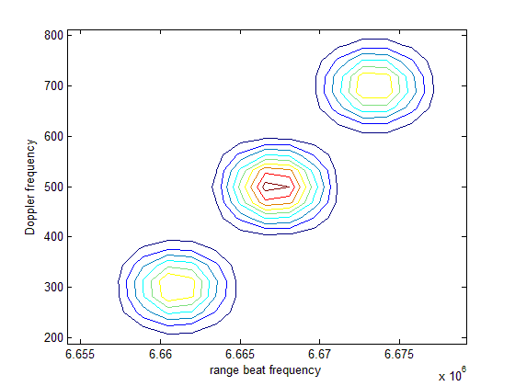
Effect on Doppler processing
Sinusoidal phase error, 3 cycles per sweep, amplitude 0.1 radian
Sinusoidal phase error, 3.1 cycles per sweep, amplitude 0.1 radian
Systematic phase errors have negligible effect on Doppler processing

Slide 29
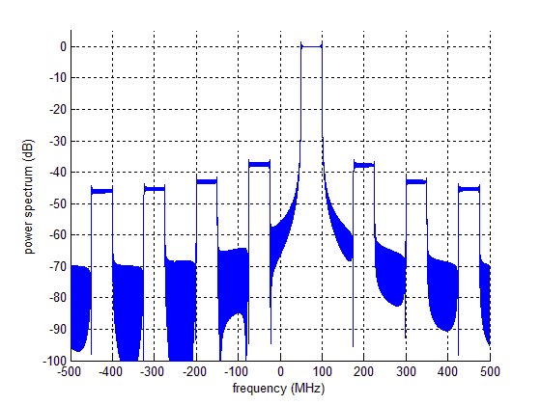

Spectrum of the complex exponential
‘signal’
‘replicas’
$$θ_{m}=\frac{\left[0,1,…,7\right]}{8} radians$$

Slide 30
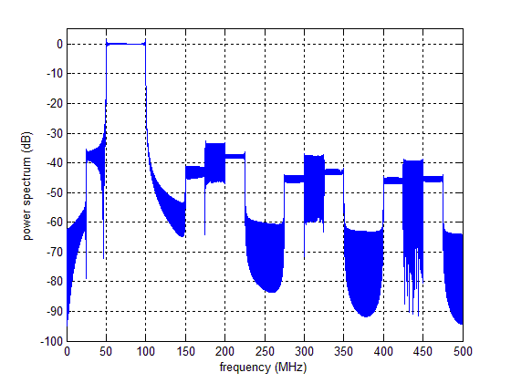
Spectrum of the analytic signal
‘main’ signal
‘signal replica’
‘image replica’

Slide 31
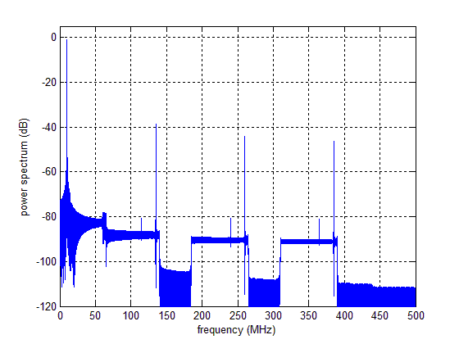
Observed beat signal
‘signal ×signal’
‘signal × signal replica’
‘image replica × image replica’
‘signal × image replica’

