Slide 1
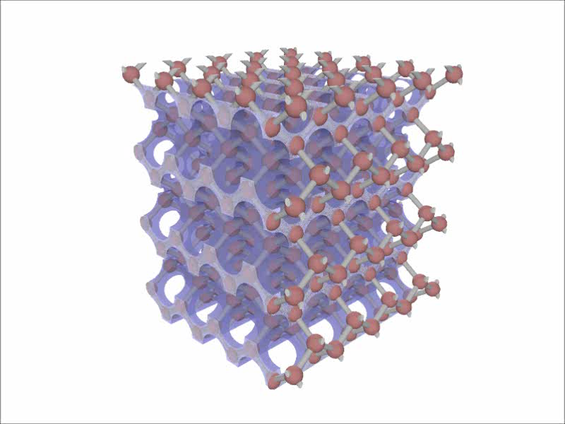
«Traité de la lumière»?
Traitons ces photons!
Willem Vos
Complex Photonic Systems (COPS)
MESA+ Institute for Nanotechnology
University of Twente
Enschede
Pays-Bas
www.complexphotonicsystems.com
#jesuischarlie
www.youtube.com/watch?v=MH0WGqHI1ss
[Model of diamond structure
used to “treat” photons]
Notes:
Animation by Leon Woldering, available on Youtube as listed; see also the two papers below:
J. M. van den Broek, L. A. Woldering, R. W. Tjerkstra, F. B. Segerink, I. D. Setija, and W. L. Vos
Adv. Func. Mater. 22, 25 - 31 (2012)
Inverse-woodpile photonic band gap crystals with a cubic diamond-like structure made from single-crystalline silicon
R. W. Tjerkstra, L. A. Woldering, J. M. van den Broek, F. Roozeboom, I. D. Setija, and W. L. Vos
J. Vac. Sci. Technol. B 29, 061604: 1-8 (2011)
A method to pattern masks in two inclined planes for three-dimensional nano- and microfabrication

Slide 2
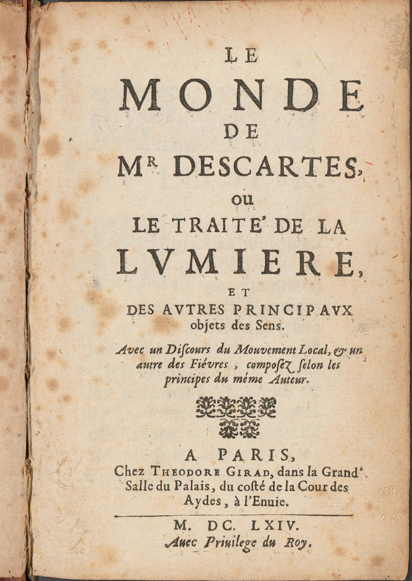
On shoulder of giants: Descartes
The World of Mr. Descartes or
the Treatise of Light
(1632 – 1664)
+ What we see differs from
what causes a phenomenon
+ Reflection, refraction at
interface [“Snell & Descartes”]
- Light as infinitely fast bullets
“Postdoc” at Univ. Franeker

Slide 3
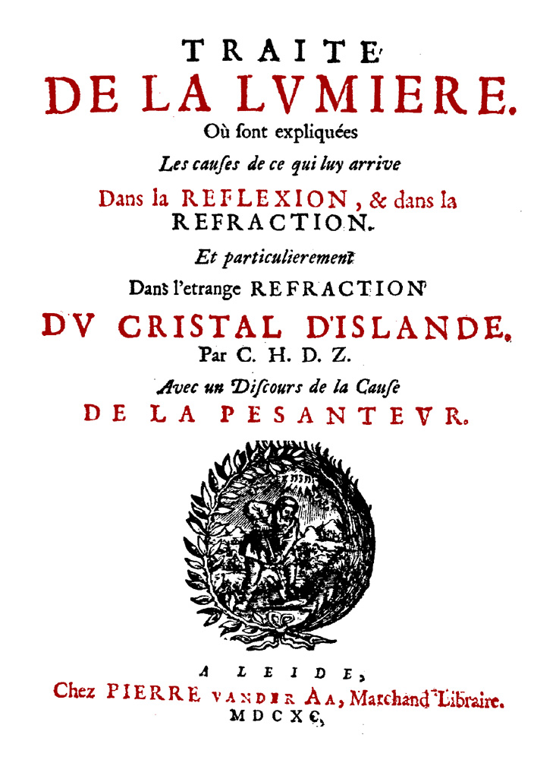
On shoulder of giants: Huygens
Treatise of Light (1690)
+ Describes light as waves
that expand from source
+ Describes refraction of
polarized light (birefringence)
- Unclear why light doesn’t go
backward [Fresnel&Kirchhoff]
Good old days:
Dutch physicists wrote in French!

Slide 4
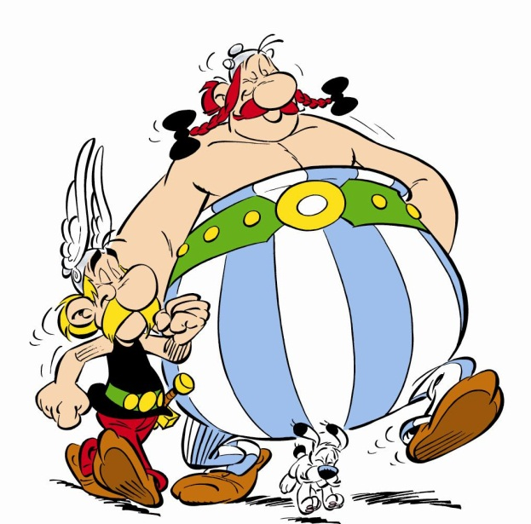
Outline
On the shoulders of giants D&H
See through an opaque screen
When are photons emitted
Which inspiration from France?
Many thanks

Slide 5
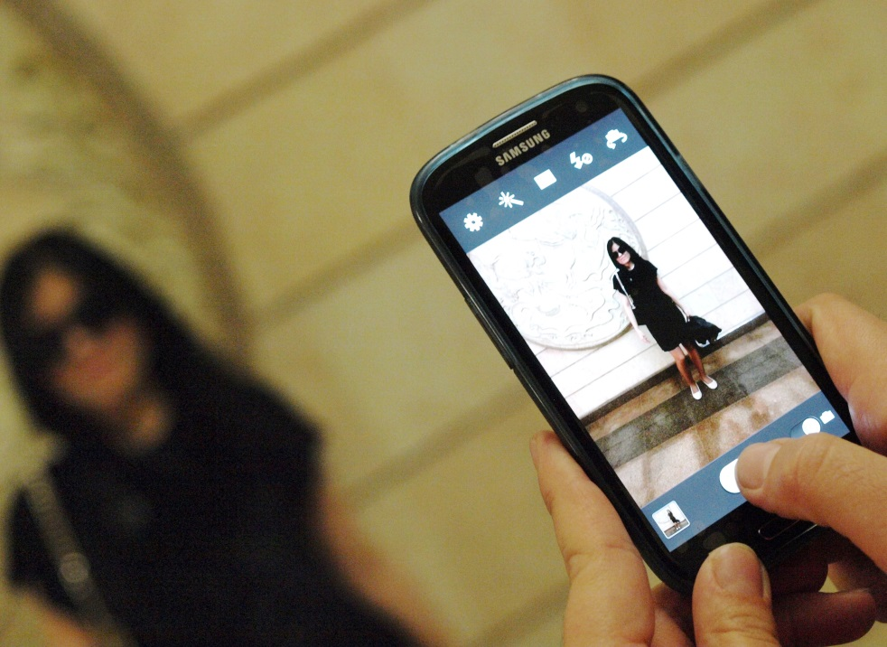
Take an image (modern way)
Photography: create durable
image by recording light
Camera has unobstructed
view at object
Medium between object &
lens does not distort light
(here: air, transparent.)
commons.wikimedia.org/wiki, Petar Milošević

Slide 6
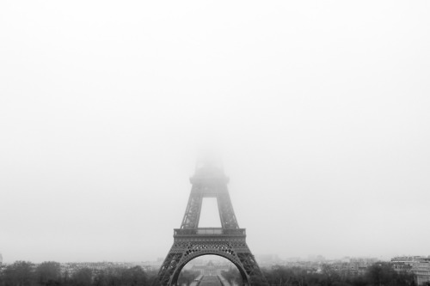
Limit to imaging
Obviously, it is hard to take
pictures in (opaque) fog
In medium between
object & camera,
tiny water droplets (=fog)
“confuse” course of light
Therefore we cannot see the top of this well-known tower
//kelleyswain.files.wordpress.com/2011/11/eiffel-tower-in-fog.jpg, Petar Milošević

Slide 7
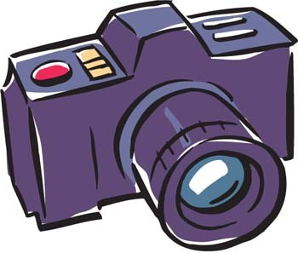
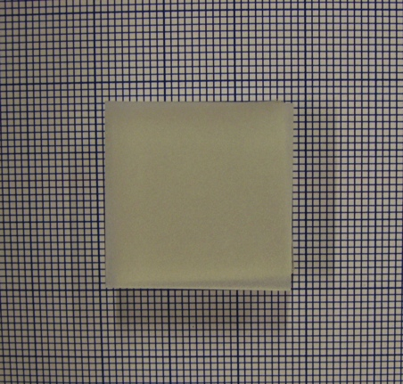
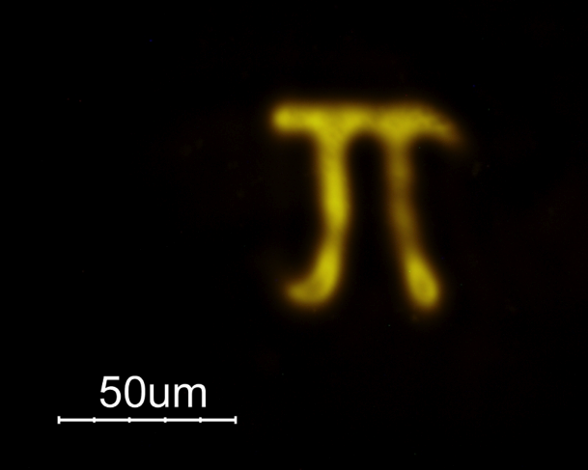

Apparatus to see through screen
Diffuser
(opaque!)
Hidden object
θy
6 mm
Essential tricks:
Perform rotations,
Angle-correlations &
Image reconstruction
θx
λ=532 nm

Slide 8
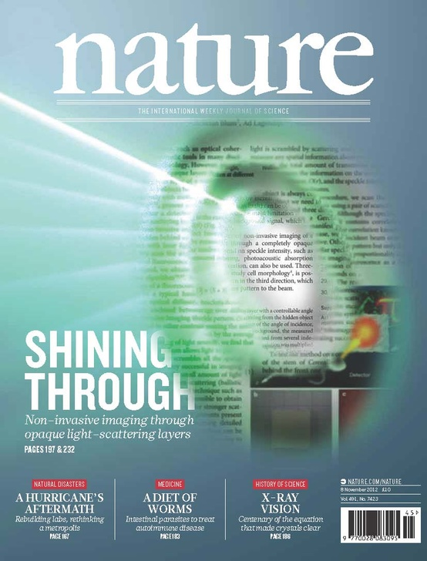
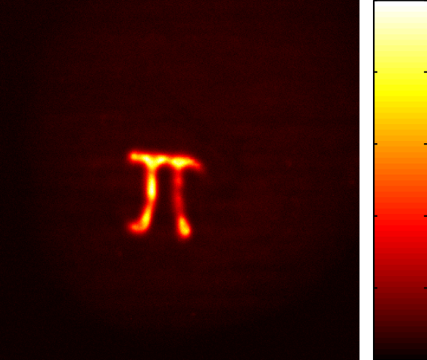
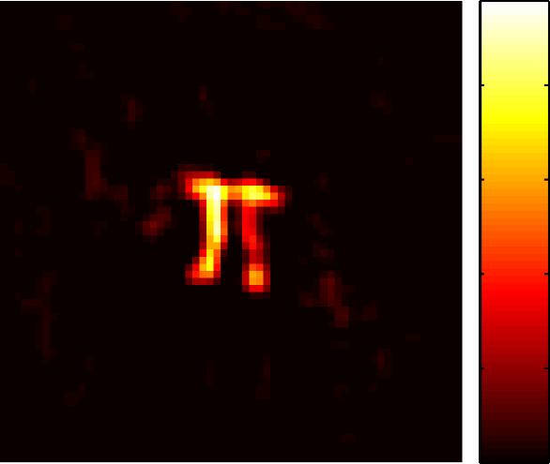
Look through opaque screen!
Object
(before)
Object
(recovered)
100 μm
Bertolotti, van Putten, Blum, Lagendijk, WLV & Mosk, Nature 491 (2012) 232

Slide 9
Outline
On the shoulders of giants D&H
See through an opaque screen
When are photons emitted
(“photonic birth control” ;-)
Which inspiration from France?
Many thanks

Slide 10
“How a photon is born”
Elementary source has 2 levels:
1. High energy (“excited state”)
2. Low energy (“ground state”)
At time=0:
source prepared in excited state & no photon present
After random moment in time:
source back to ground state & 1 photon detected: “click”
[“God rolls dice”, which Einstein supposedly didn’t like.]
ħω
2-level source
photon

Slide 11
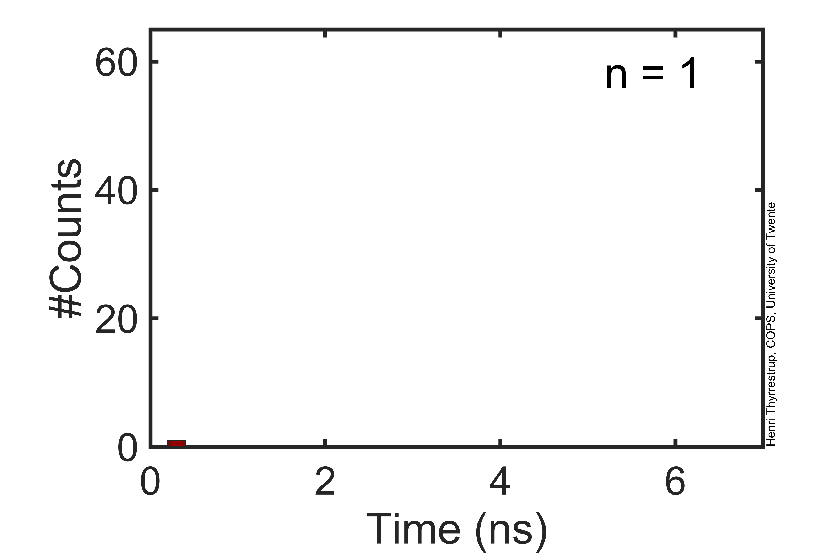
“Birth moments” are random
Histogram of
random photon
detection events
Add up many
events:
exponential
distribution
Slope gives
“Lifetime“ = how long source remains in excited state
Notes:
Animation made by Henry Thyrrestrup Nielsen (COPS, Univ. Twente)

Slide 12
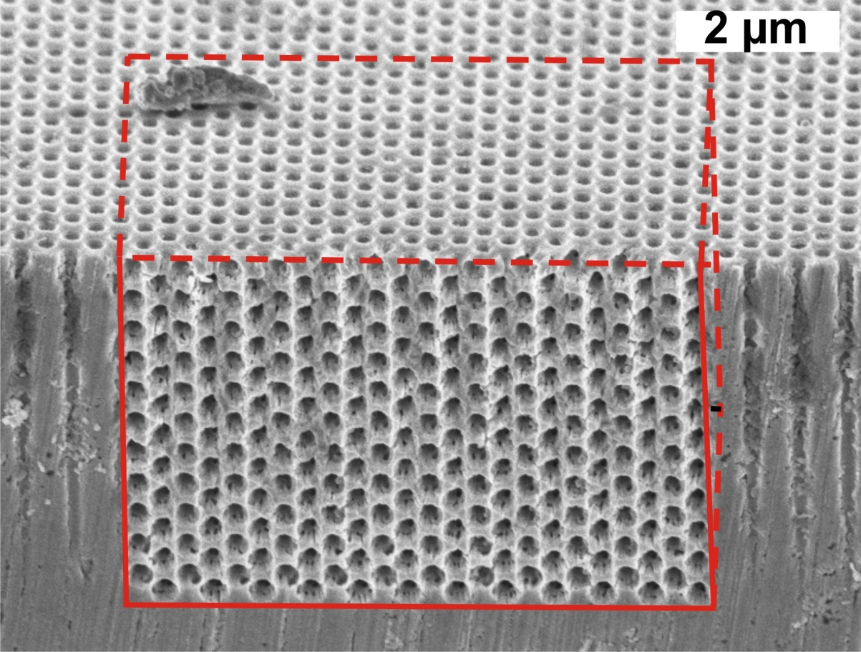
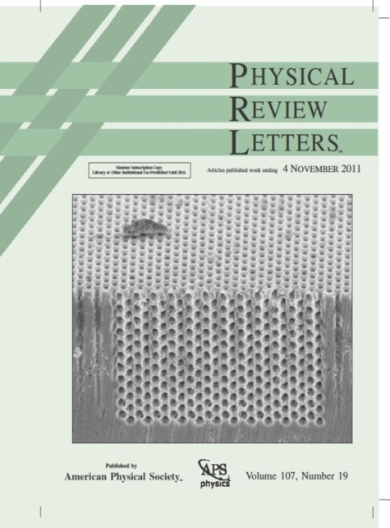
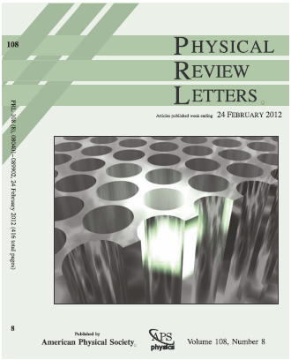
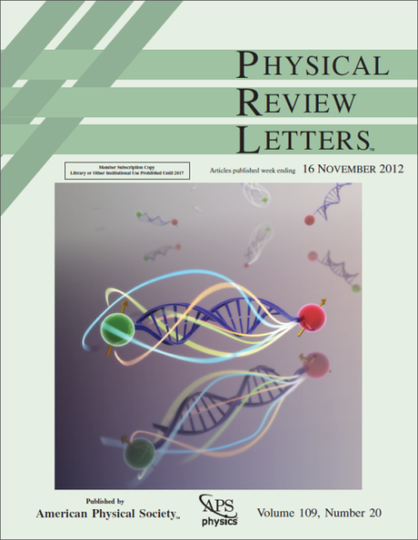
Photonic “birth-control device”
We have made
3D photonic band gap
crystals from silicon,
diamond-like structure
Within such a crystal
sources have very long
lifetimes (20x longer!)
Leistikow et al, PRL 107 (2011) 193903; Huisman et al, PRL 108 (2012) 083901; Blum et al, PRL 109 (2012) 203601;
Collaborations with: ASML, TNO, Philips

Slide 13
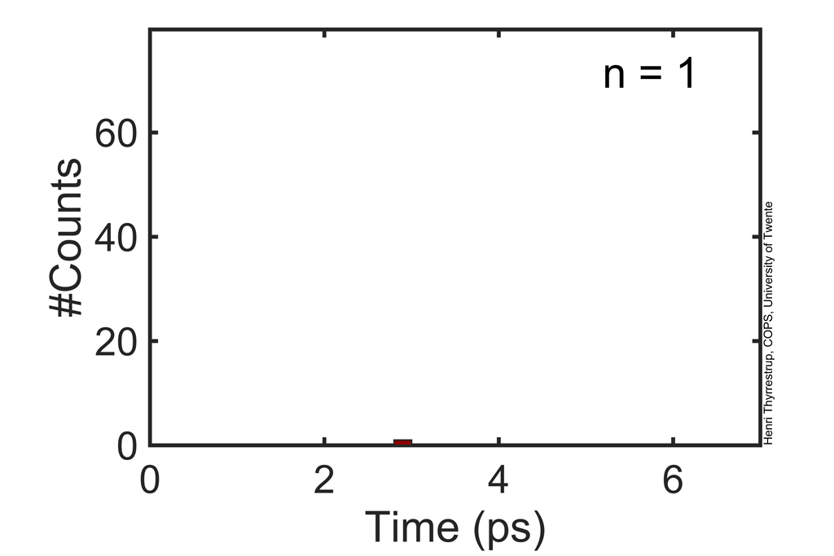
Goal: photons at desired moment
Sources inside
tiny resonator
& control pulses
Photons still
random, but
at times
decided by us!
[“Show Einstein
how to play dice”?]
With INAC/CEA/Université Joseph Fourier, team of Jean-Michel Gérard
Notes:
Histogram calculated by Henry Thyrrestrup Nielsen (COPS, UTwente); see also the paper by:
H. Thyrrestrup, A. Hartsuiker, J. M. Gérard, and W. L. Vos
Opt. Express 21, 23130-23144 (2013)
“Non-exponential spontaneous emission dynamics for emitters in a time-dependent optical cavity”

Slide 14
Outline
On the shoulders of giants D&H
See through an opaque screen
When are photons emitted
Which inspiration from France? (3x)
Thanks

Slide 15
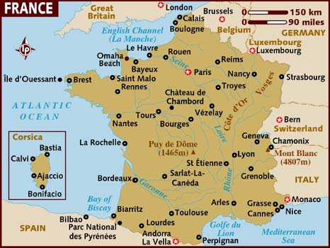
1: Fast connected hi-tech centers
From Grenoble
nice opportunity
to also visit other
hi-tech centers:
Paris
Lille
Strasbourg
Toulouse
etc.
Skype is great, but
talking “live” & seeing your lab & your samples: crucial!
3.5 hrs
3 hrs
3.5 hrs
4 h.

Slide 16
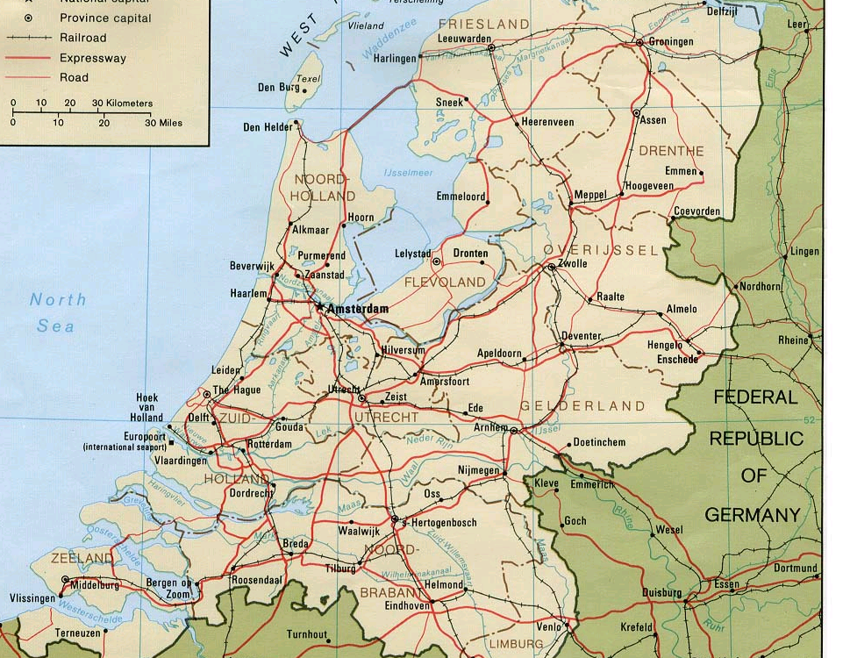
1: NL similar size as France (?)
In NL:
connections
between
hi-tech
centers
not very
fast…
Slows
down
innovation
3.5 hrs
3.5 hrs
2 hrs
3.5 hrs

Slide 17
1: Faster innovation
More fast
connections
between
Dutch
hi-tech
“Innovation-
TGV”:
Groningen-
Twente-
Nijmegen-
Eindhoven
in 2 hrs.

Slide 18
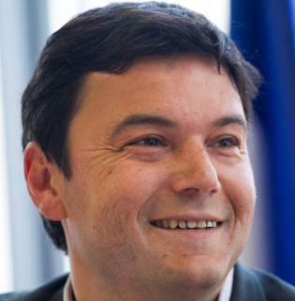
2: “Piketty” in science?
Why I admire France: Public debates about major issues
E.g.: T. Piketty & wealth distribution & “winner takes it all”
Similar trend in modern science funding:
huge grant schemes (*)
→ Predictable topics; bad for diversity;
young generation stands no chance
Effective funding schemes such as
“FOM Projectruimte”
“STW Open Technologie Programma”
must be saved & enhanced, espec. for young scientists
(*) e.g. K. Landsman “It’s all about bucks Kid, rest is conversation” link (2013)
I am curious to learn how the French organize funding?

Slide 19
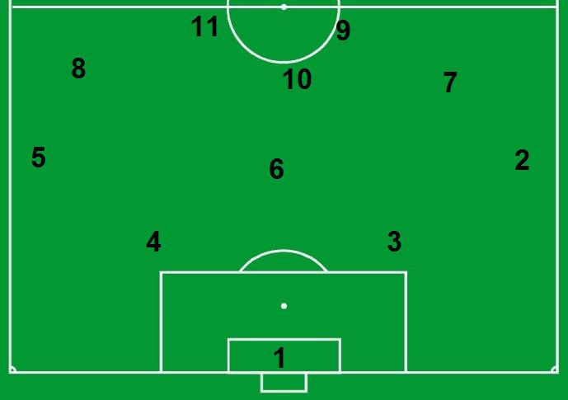
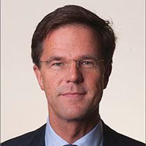
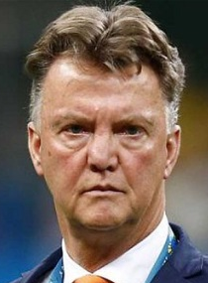
3: Near-future science policy
football tells
football coach
who to
select,
& team must be
interdisciplinary
(swim, judo, ..)
New plans of NL government about science organization...
Metaphor:
Robin
v Persie
Arjen
Robben
Sven
Kramer
Epke
Zonderland
Marianne
Vos
Ranomi
Kromowidjojo
Johan
Cruijff
Naomi
van As
Christiaan
Huijgens
Ireen
Wüst
Will this team become World Champions 2018? Hmm…
Dennis vd Geest

Slide 20
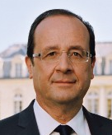
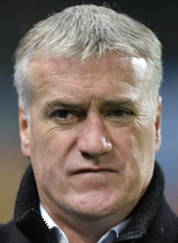
3: Near-future science policy
Metaphor transposed to the French situation…
  tells
football coach
who to
select,
& team must be
interdisciplinary
(swim, judo, ..)
Franck
Ribéry
Karim
Benzema
Bernard
Hinault
Martin
Fourcade
Alain
Prost
Laure
Manaudou
Michel
Platini
Stephane
Peterhansel
René
Descartes
Tessa
Worley
Teddy Riner
So I am curious to learn about French science policy?

Slide 21
Outline
On the shoulders of giants D&H
See through an opaque screen
When are photons emitted
Which inspiration from France?
Many thanks

Slide 22

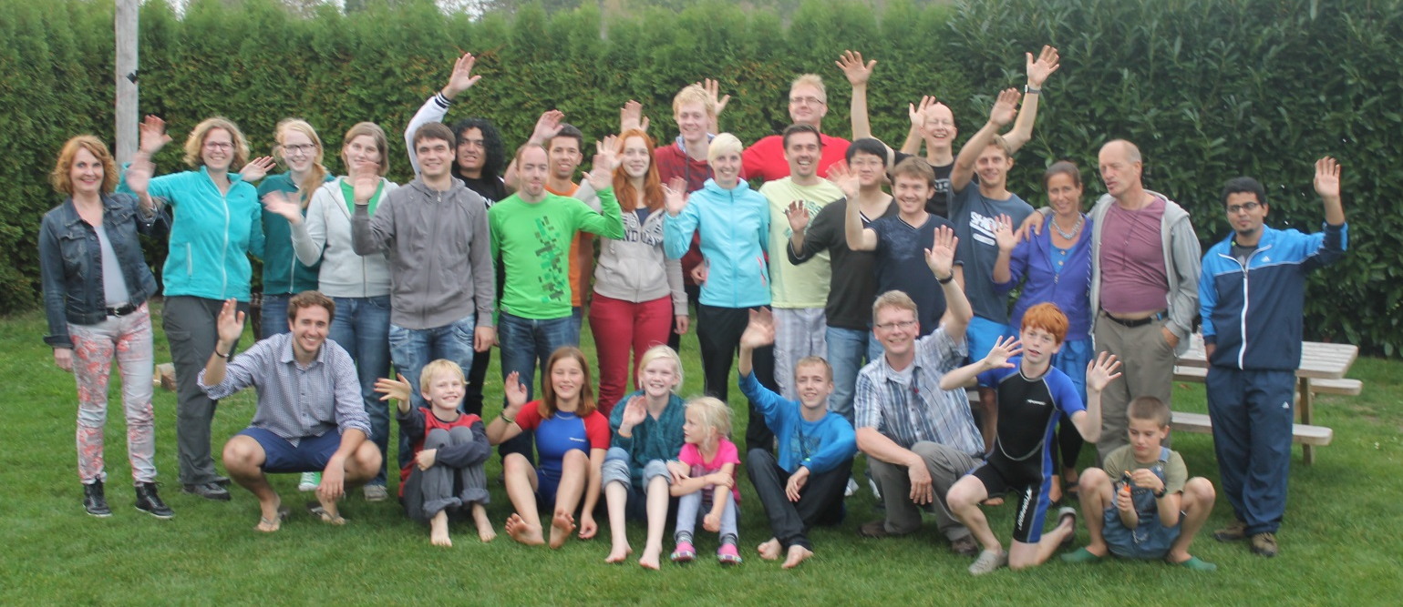
Many thanks to the COPS
Allard Mosk
Pepijn Pinkse
Ad Lagendijk
Cock Harteveld
Nilda Rijpma
Marlon Gomperts
Lyuba Amitonova
Henri Thyrrestrup
Emre Yüce
Devashish, Bas Goorden, Diana Grishina, Jin Lian, Evangelos Marakis, Maryna Meretska, Femi Ojambati, Andreas Schulz, Sergei Sokolov, Tristan Tentrup, Tom Wolterink, Hasan Yilmaz
Jeroen Bosch, Jan Hofste, Rik de Ruiter

Slide 23





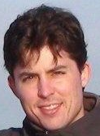
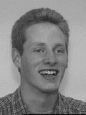
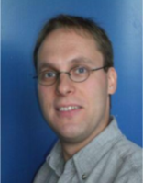
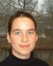
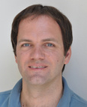
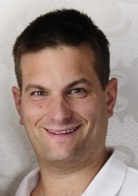
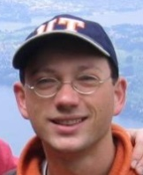
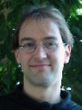
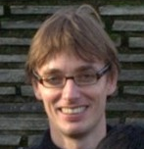
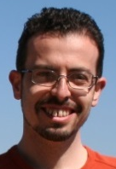
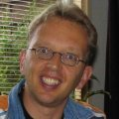
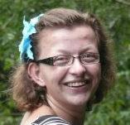
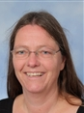
Thanks: PhDs, postdocs, techs
Elahe Yeganegi, Simon Huisman, Duygu Akbulut
Emre Yüce, Merel Leistikow, Alex Hartsuiker
Bart Husken, Leon Woldering, Philip Harding
Tijmen Euser, Floris van Driel, Ivan Nikolaev
Femius Koenderink, Lydia Bechger,
Jaime Gomez Rivas, Mischa Megens
Georgios Ctistis, Vanessa Leung,
Jacopo Bertolotti, Willem Tjerkstra,
Danang Birowosuto, Peter Lodahl,
Patrick Johnson, Henry Schriemer,
Arnout Imhof
Hannie vd Broek, Judith Wijnhoven,
Carlos van Kats

Slide 24
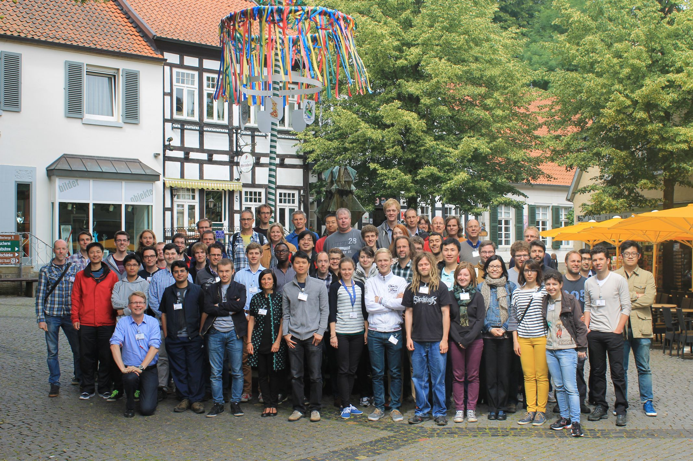
Applied Nanophotonics Twente
Close
collaboration
of 6 research
Chairs in
MESA+
Institute
~75 people
largest NL
nano-optics
community
Shown here on 2014 Workshop in Tecklenburg (D)

Slide 25
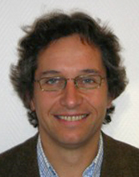
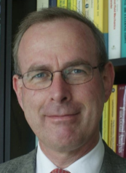
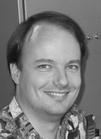
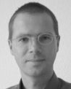
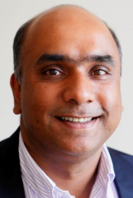
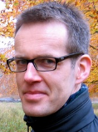
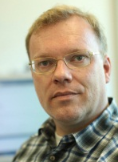
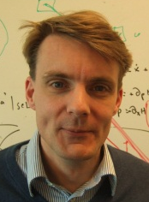
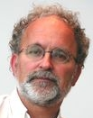
Thanks: collaborating teams
Jean-Michel Gérard (CEA/UJF France)
Jaap van der Vegt, Klaus Boller (UT)
Jurriaan Huskens, Julius Vancso (UT)
Christian Blum (UT)
Vinod Subramaniam (Amolf)
Meint Smit (TUE)
Martijn Wubs (DTU Denmark)
Arie den Boef, Jo Finders (ASML)
Wilbert IJzerman & Teus Tukker (Philips Lighting)
Fred Roozeboom, Henri Werij (TNO)
Alfredo de Rossi (Thales France)

Slide 26



Thanks: mentors & advisors
Ad Lagendijk
for lessons on light scattering,
great physics & how to present it,
society in general
Ho-kwang Mao & Russell Hemley
(Carnegie, Washington) for showing a
naïve young postdoc true excellence
[HM: 4 Natl. Acad.+46 Science+20 Nature+66 PRL]

Slide 27






Thanks: funding agents & institute
.

Slide 28
Grand merci: family & friends
Jan Vos
Liesbeth Vos en Jan van Ravenhorst
Pauline Vos
Fam. Wolterbeek & van ‘t Hoff
Marco Brugmans
Raymond Oudeboon

Slide 29

Special dedication
I wish to dedicate the
Prix Descartes-Huygens
to my mother Tin Vos (1931-2005)
Teacher in Enschede of handicapped kids
Tin has always strongly stimulated us to “move ahead”
“With your capacities, you must DO something!”

Slide 30
Thanks to my beloved ladies
Johanna & Milja
(since 20 Oct. 2014)
and my dear wife: Acca Kapteijn!!!!

Slide 31
Merci beaucoup!!!
I am deeply grateful to:
+ Ministère de de l’Éducation nationale, de l’Enseignement supérieur et de la Recherche
+ Ministère des Affaires étrangères et du Développement international / Ambassade de France aux Pays-Bas
+ Académie des sciences de France
for awarding me the Descartes-Huygens Prize
Merci beaucoup, beaucoup, beaucoup!!!

