Slide 1
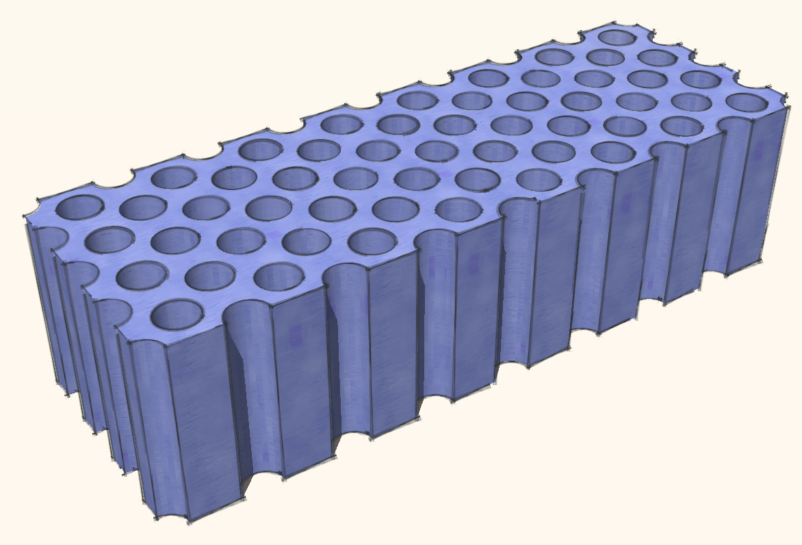
Observation of sub-Bragg diffraction of waves
Simon R. Huisman, Rajesh V. Nair, Alex Hartsuiker,
Léon A. Woldering, Allard P. Mosk, Willem L. Vos
s.r.huisman@utwente.nl

Slide 2
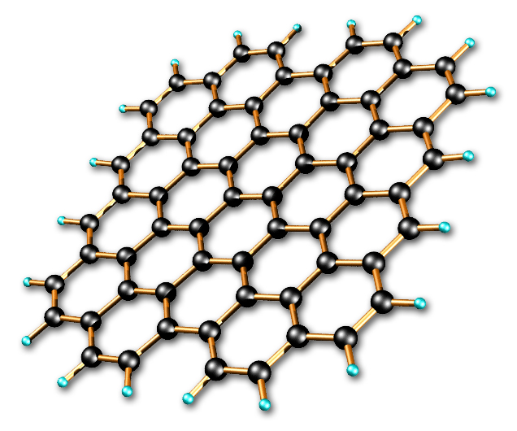
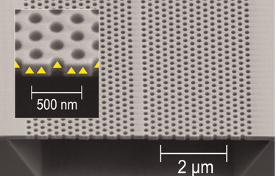
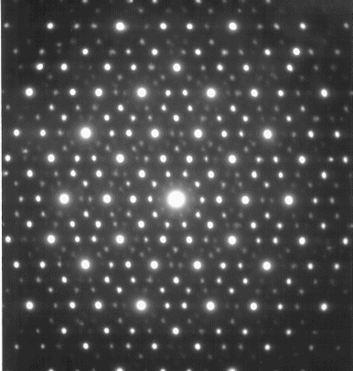
Waves in periodic media
Graphene
Photonic crystal waveguide
X-ray diffraction
The propagation and scattering of waves are strongly modified by periodic structures.
Stopgaps emerge due to Bragg diffraction.

Slide 3
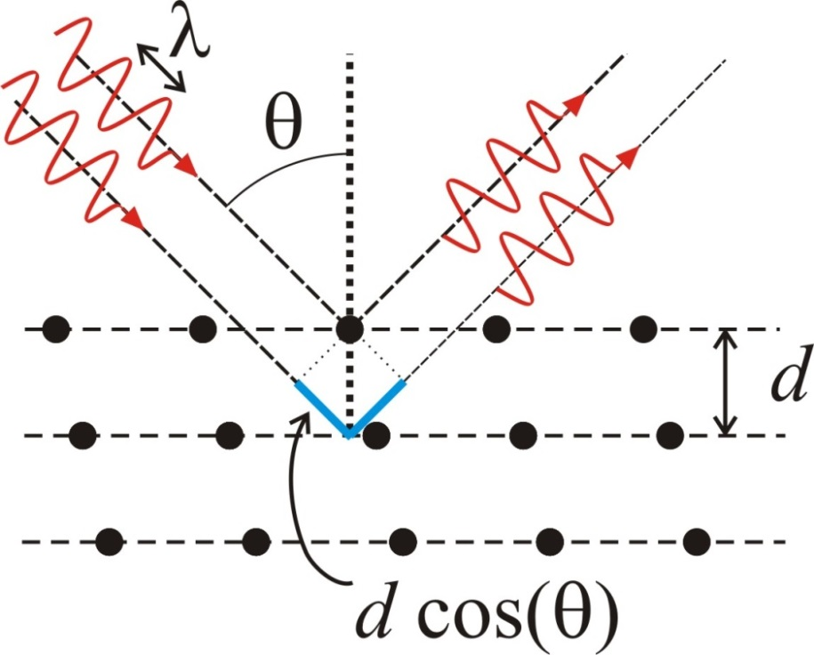
Bragg diffraction
Bragg diffraction condition:
In reciprocal space:
(von Laue)
One would expect for directions of high-symmetry, the
lowest-frequency simple-Bragg diffraction occurs at:

Slide 4
Bragg diffraction
Bragg diffraction condition:
In reciprocal space:
(von Laue)
One would expect for directions of high-symmetry, the
lowest-frequency simple-Bragg diffraction occurs at:
This statement is wrong.
We find a significant stopband below the first-order simple-Bragg condition.

Slide 5
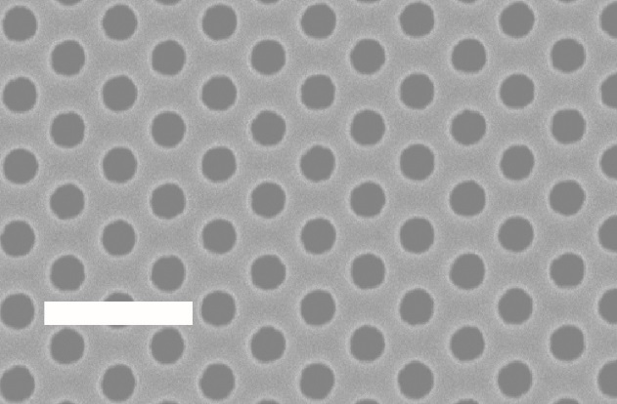
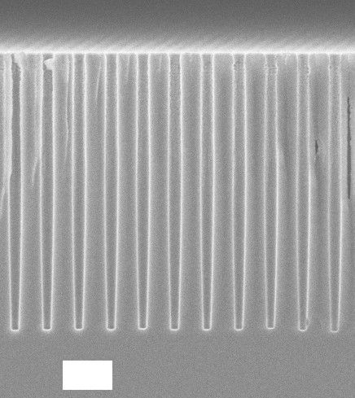
Silicon 2D photonic crystals
1 μm
  Measure reflectivity from these crystals
1 μm

Slide 6
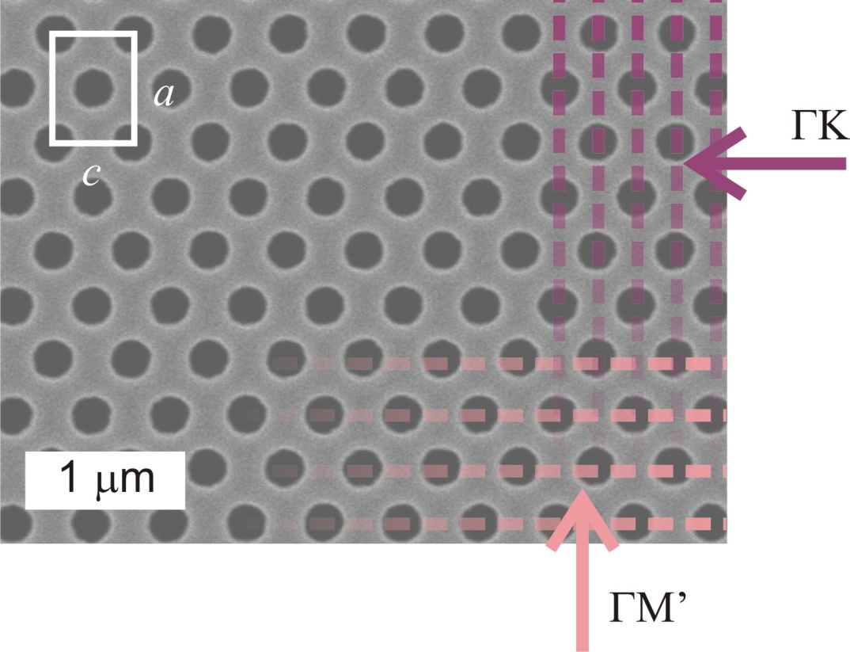
Silicon 2D photonic crystals
  Measure reflectivity from these crystals
1 μm

Slide 7
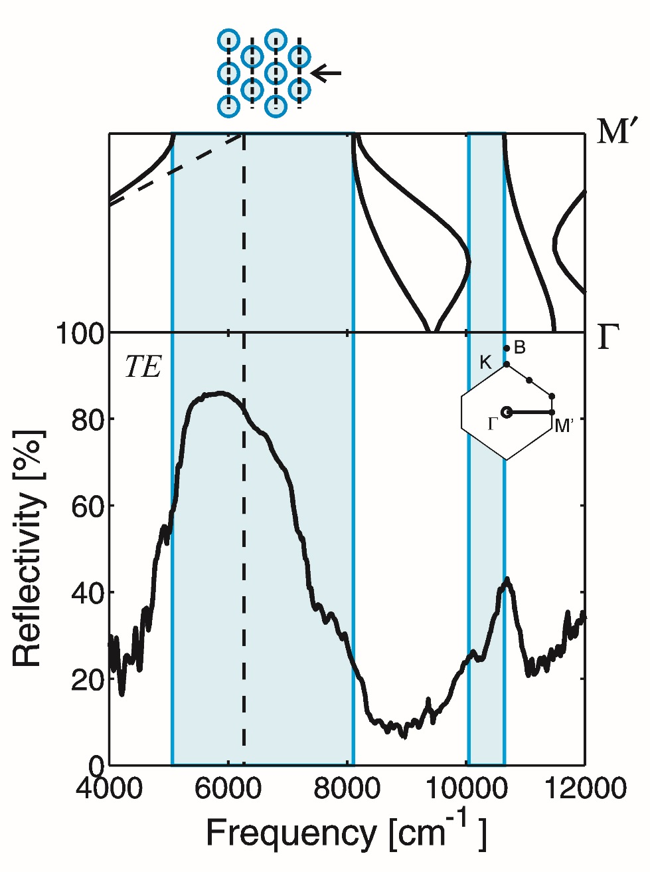
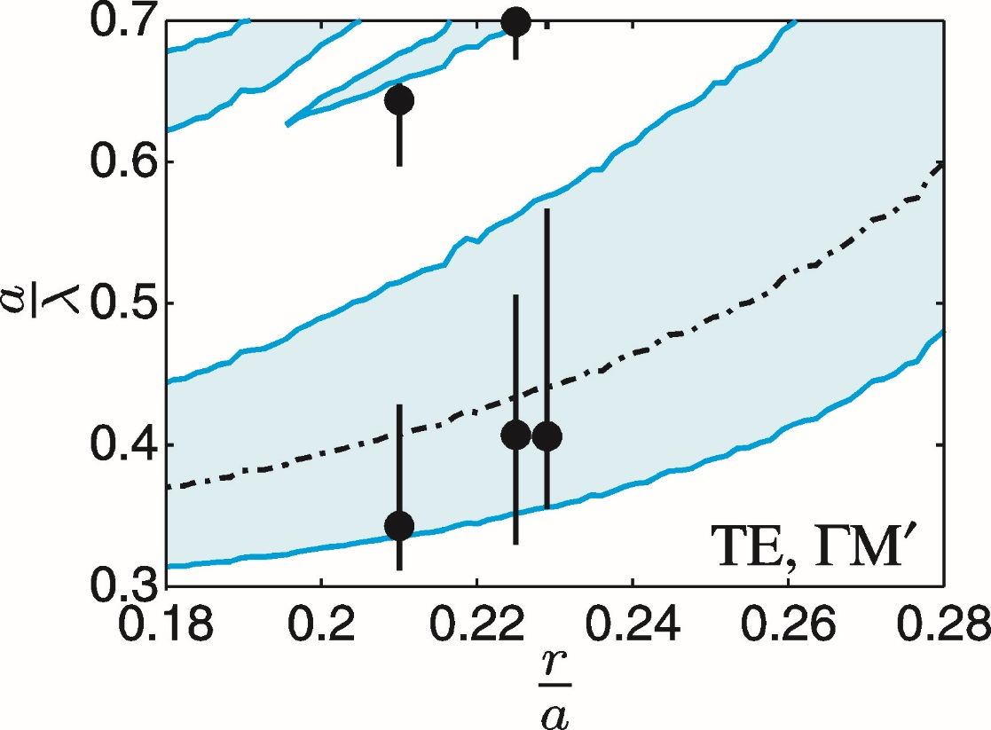
ΓΜ’-direction
  Agreement with calculated stopgaps
  Simple-Bragg lowest frequency.

Slide 8
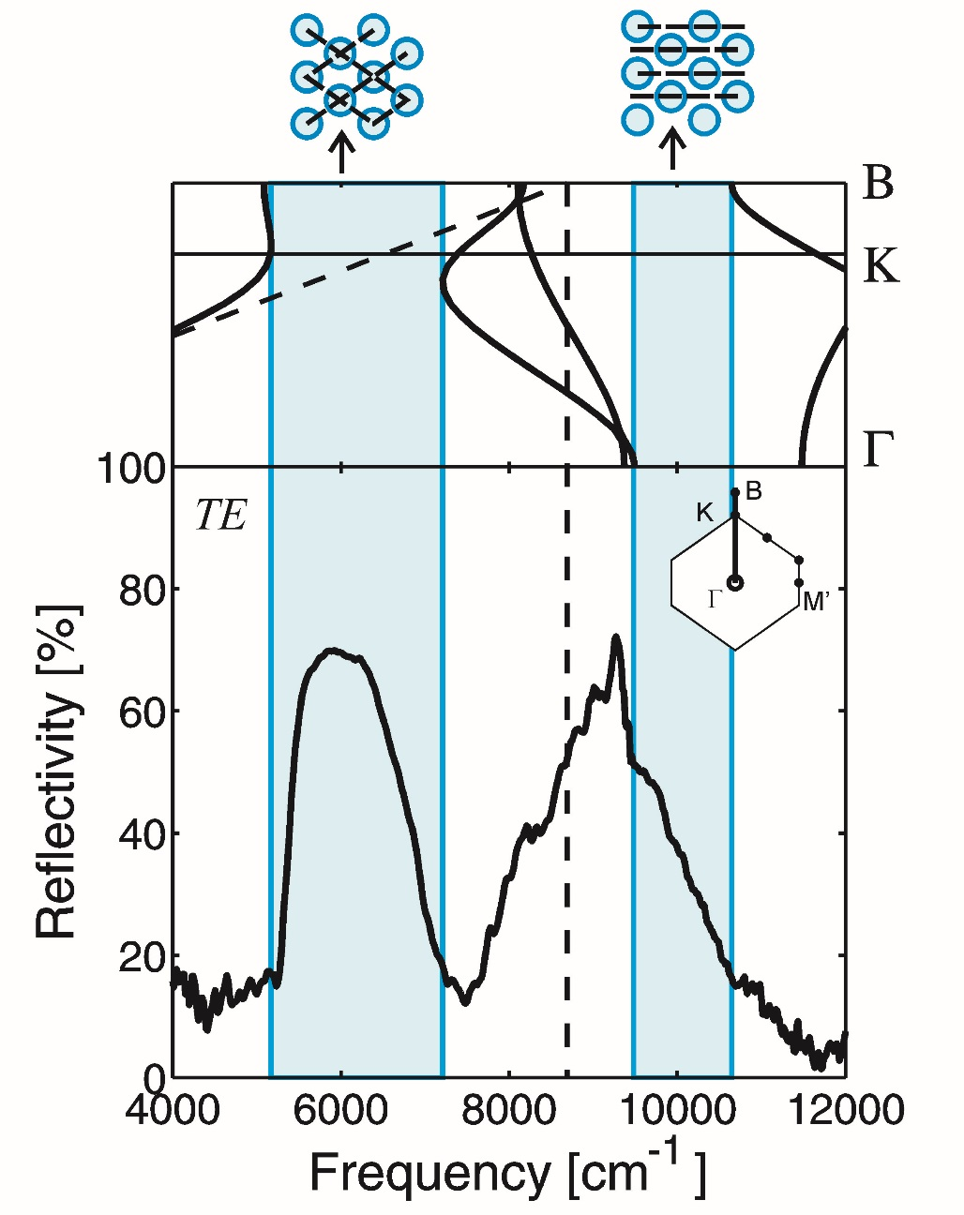
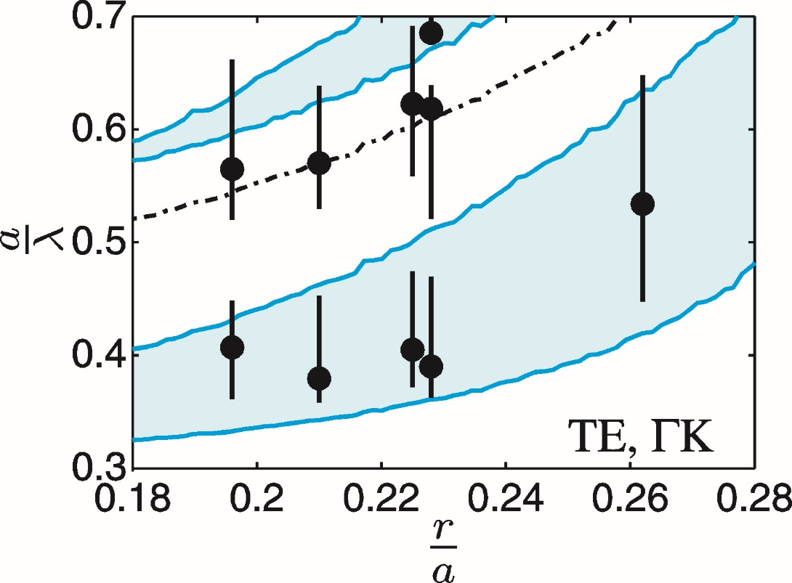
ΓΚ’-direction
  Agreement with calculated stopgaps
  Simple-Bragg not lowest frequency

Slide 9
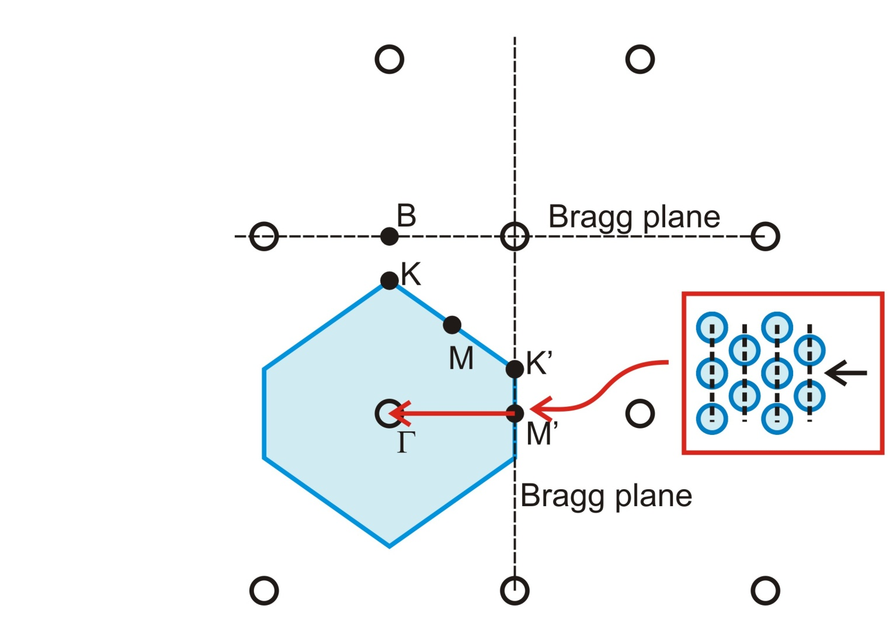
Simple-Bragg diffraction
  For ΓΜ’–direction diffraction on Μ’-point
  Μ’-point: Simple Bragg diffraction

Slide 10
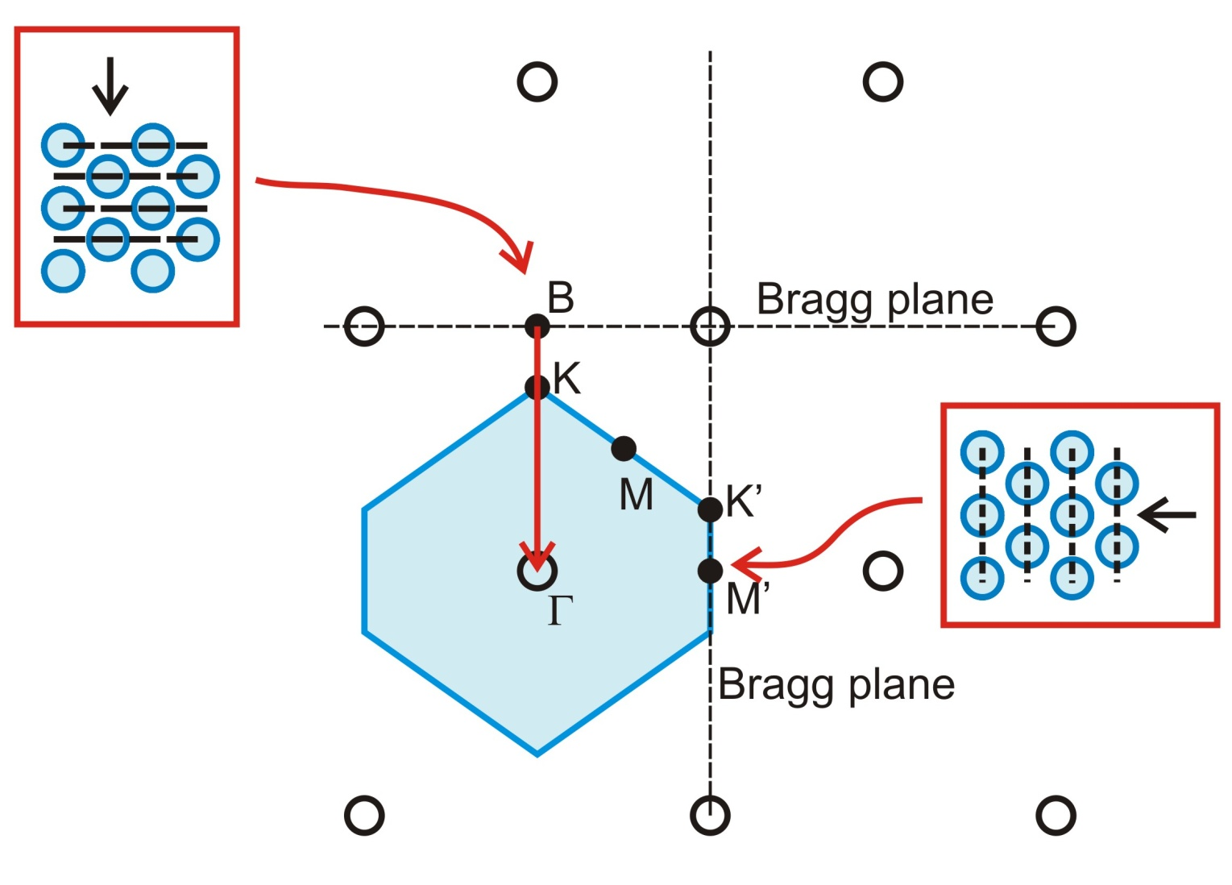
Simple-Bragg diffraction
  For ΓΚ–direction diffraction on Β-point
  Β-point: Simple Bragg diffraction

Slide 11
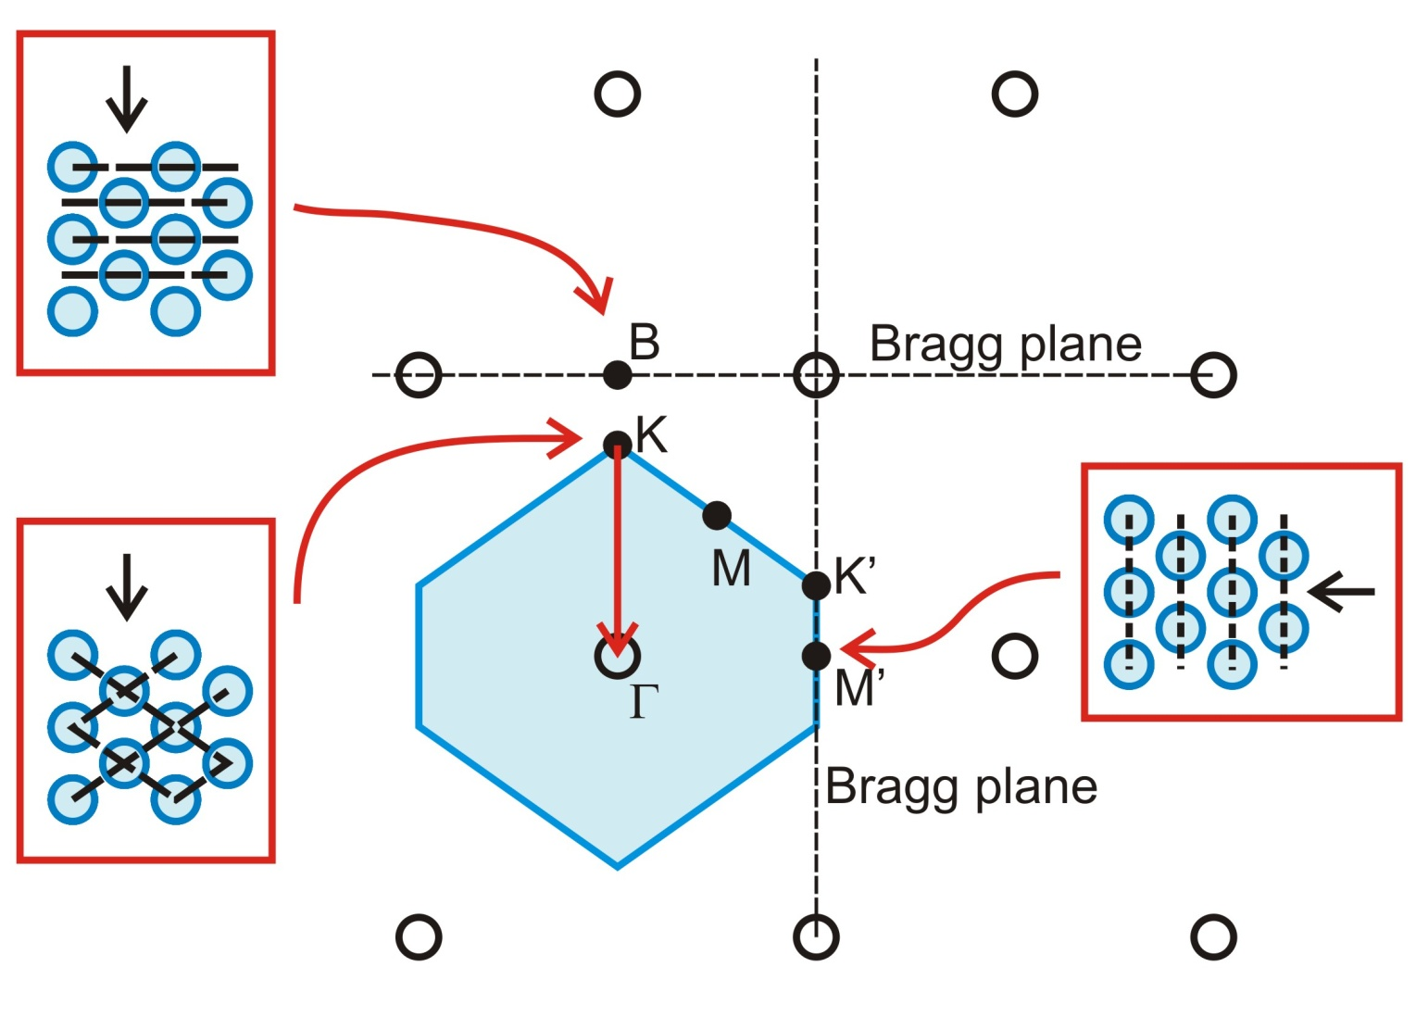
Sub-Bragg diffraction
  For ΓΚ–direction diffraction also on Κ-point
  Κ-point: multiple Bragg diffraction

Slide 12
Implications of sub-Bragg
  Valid for any type of wave in
  2D: 2 out of 5 (triangular and centred rectangular)
  3D: 7 out of 14 (including hexagonal and BCC)
  Crystallography
  Phonon scattering
  Conduction in graphene
  Critical temperature of superconductors

Slide 13
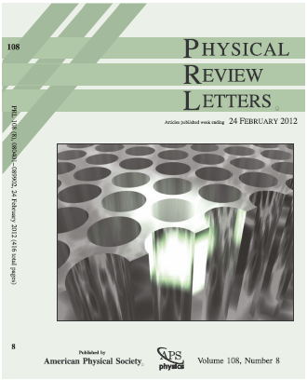
Summary
  It’s not only simply Bragg diffraction
  There can be diffraction peaks below simple Bragg diffraction.
  Published in 2012:
  S.R. Huisman, R.V. Nair, A. Hartsuiker, L.A. Woldering, A.P. Mosk, & W.L. Vos
  Observation of sub-Bragg diffraction of waves in crystals
  Phys. Rev. Lett. 108, 083901: 1-5 (2012)
  With journal front page, available from COPS website

Slide 14
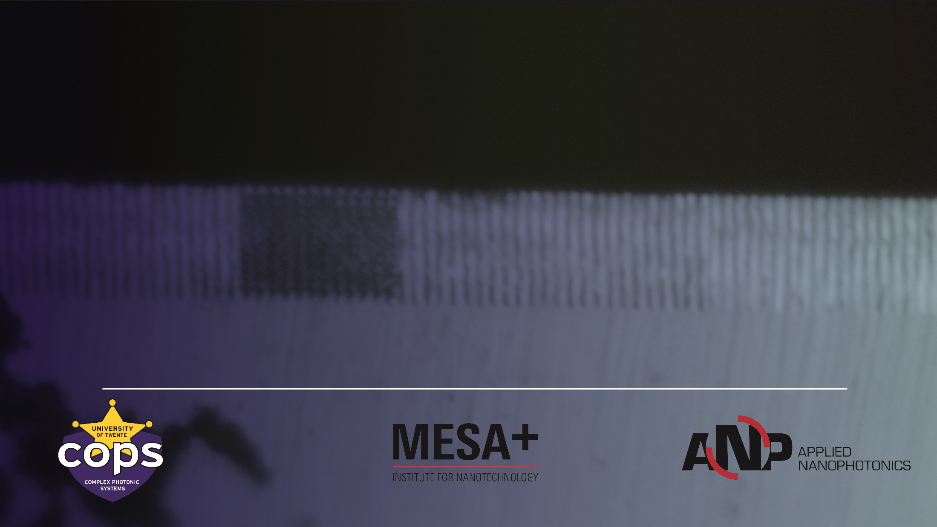
Visit us @ CLEO:
CK6.4 MON: Ultrafast switching mechanisms of microcavities
CK7.1 MON: Coherent optical imaging through opaque layers
CK7.5 MON: Focusing light through turbid media by binary amplitude modulation
EI1.3 TUE: Ultrafast switching of photonic microcavities
EI2.4 TUE: A nanophotonic probe for quantum electrodynamics in random cavities
CI2.6 TUE: Q-factor dependent Kerr-switching of microcavities

